Slide 1
Introduction for teachers
This resource can be used in a number of ways. It can be used:
to introduce Chester Cathedral
to reinforce learning after a visit to the cathedral
to compare the cathedral with a local church.
The power point is in three parts: 1. The cathedral 2. A variety of crosses in the cathedral 3. Information about the monks. There are questions to ask pupils. There are additional notes for the teacher under some slides.
Note: The pictures are copyright and only to be used in an educational context.

Slide 2
Come and see Chester Cathedral

Slide 3
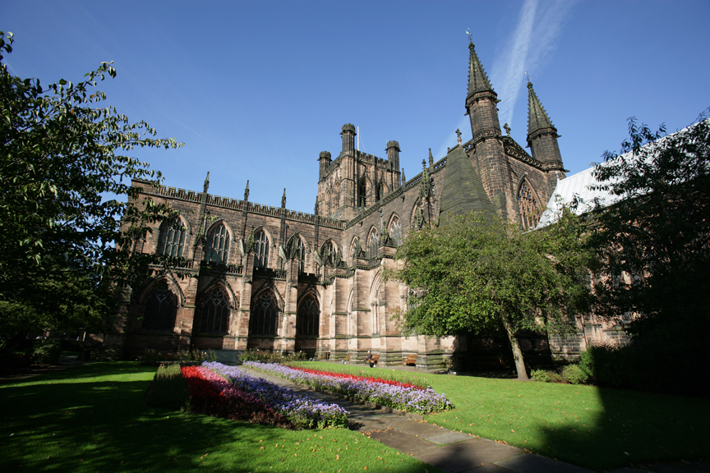
Notes:
Teacher Questions: What do you notice about the outside of the cathedral?
What would you expect to see inside this building? Sketch some pictures of what you think you might see.

Slide 4
Welcome
The entrance to the cathedral welcomes people in different languages
Notes:
Teacher Questions: How many different ways can you say welcome?
How does your school make people feel welcome?
How does your home make people feel welcome?

Slide 5
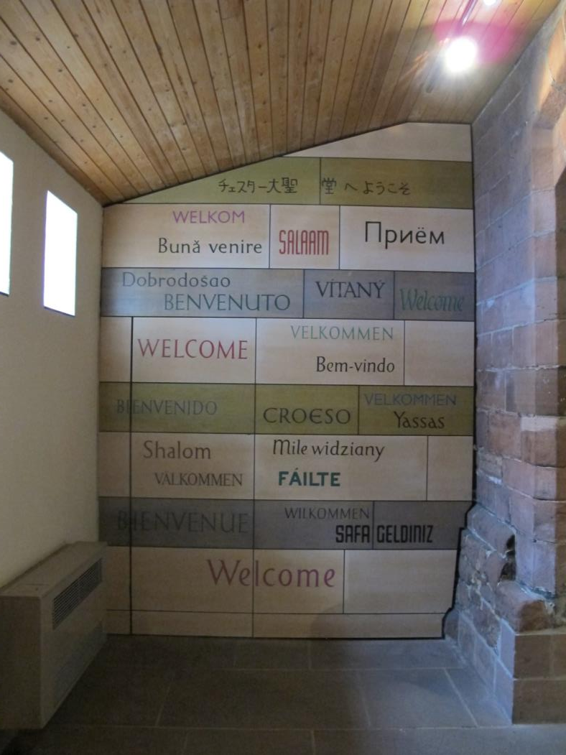
Notes:
Teachers Questions: How many languages can you see here? How many languages can you say ‘Welcome’ in?

Slide 6
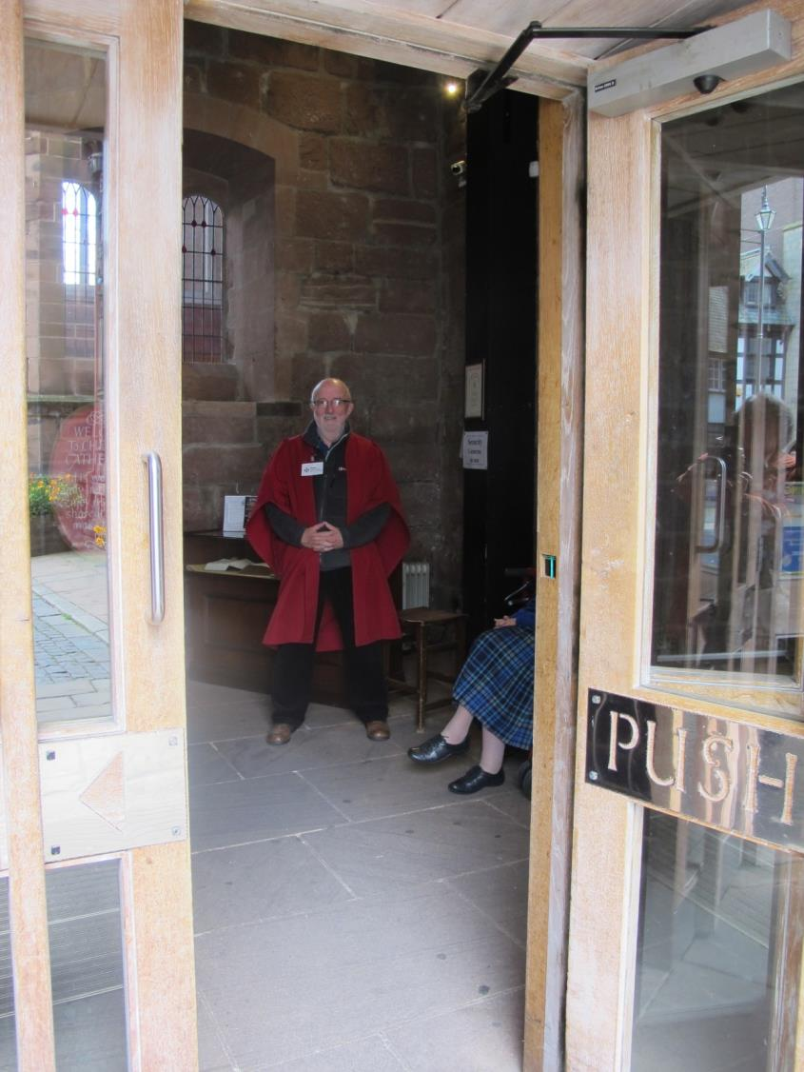
Notes:
Teacher Questions: Why do you think a cathedral has welcomers? What difference do you think it makes having people at the entrance of the cathedral to welcome

Slide 7
As you enter
When you come into the cathedral you first go into an arched passageway which is part of the cloister.
The cloisters form a square around a garden which you will see later.

Slide 8
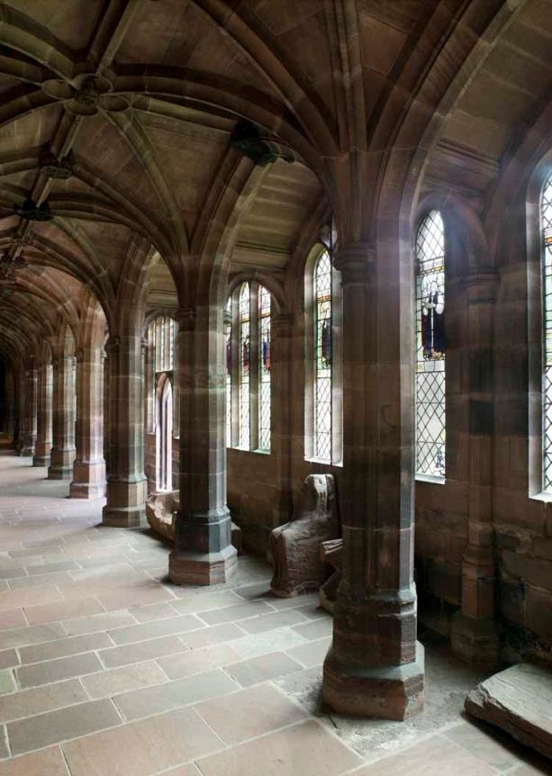
The Cloisters
Notes:
Teacher notes: Just before you go inside the cathedral, you walk here. There are 4 sides like this making a square. They are called cloisters. How many pillars can you count?

Slide 9
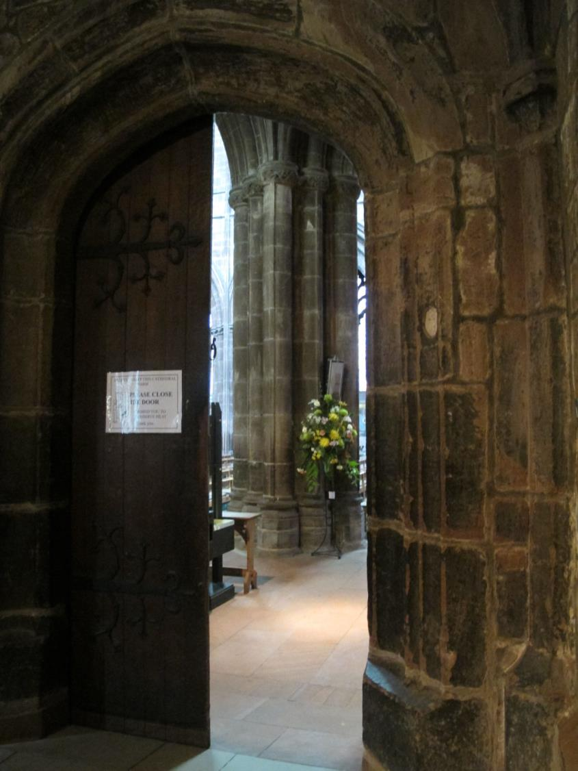
The South door from the cloisters into the cathedral
Notes:
Teacher Questions: At the end of one of the sides of the cloisters you see this door. What can you see beyond the door? Why do you think they are there? Who would you want to remember in a flower arrangement? Why? What colours would you ask for?
Note: Congregation members donate money to buy flowers in memory of someone or as a celebration.
Teacher Questions: What would you want to remember or celebrate if you paid for some flowers

Slide 10
Come and see the font
Turn right inside the door and this is what you see
Notes:
Teacher Note: the font is always by the door as a symbol of welcoming someone into the church family in baptism

Slide 11
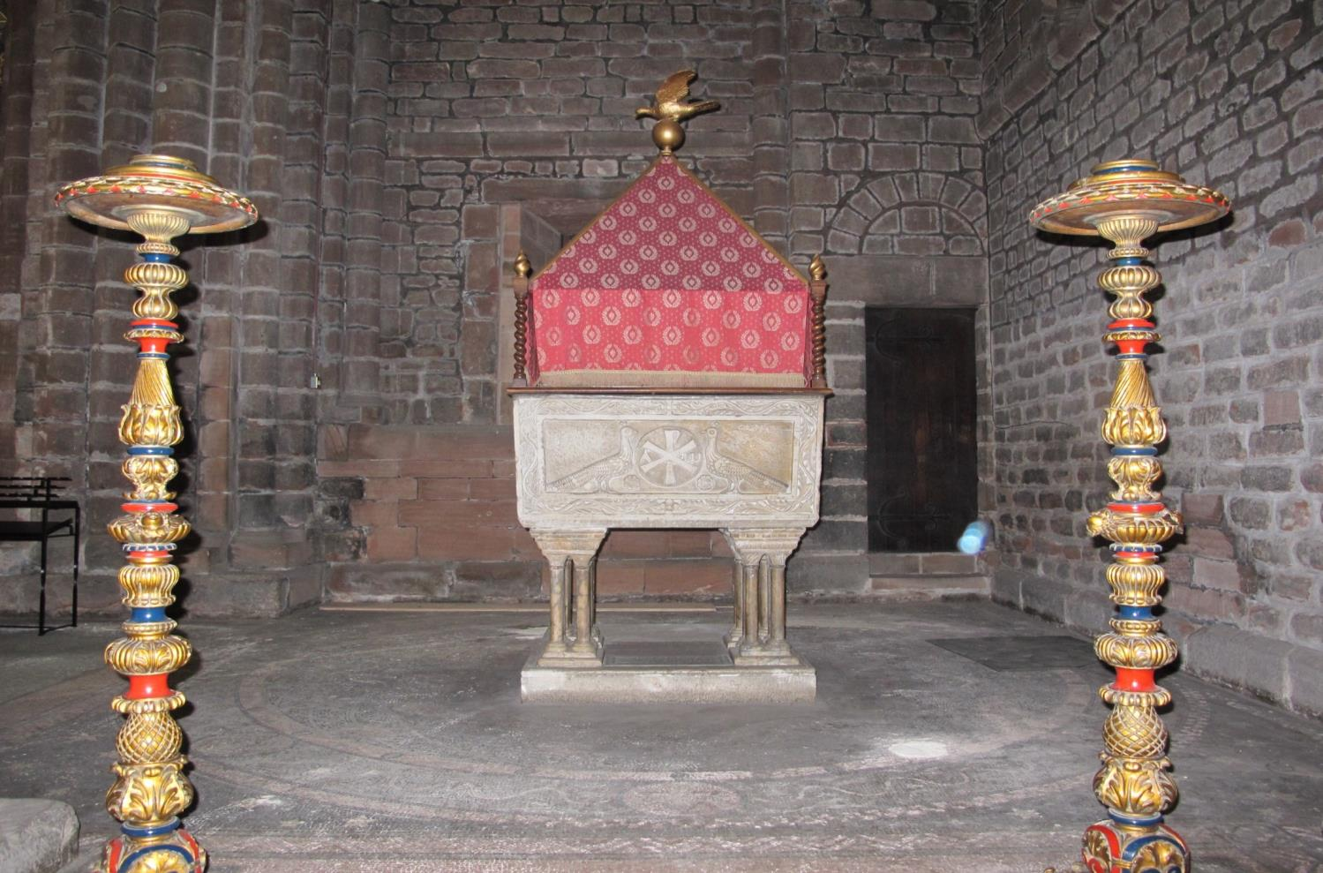
The Font
Notes:
Teacher Questions: There are two birds. What are they? (Peacock symbols of immortality – living for ever)
Why do you think the sculptor carved peacocks on the font
How and when is a font used?

Slide 12
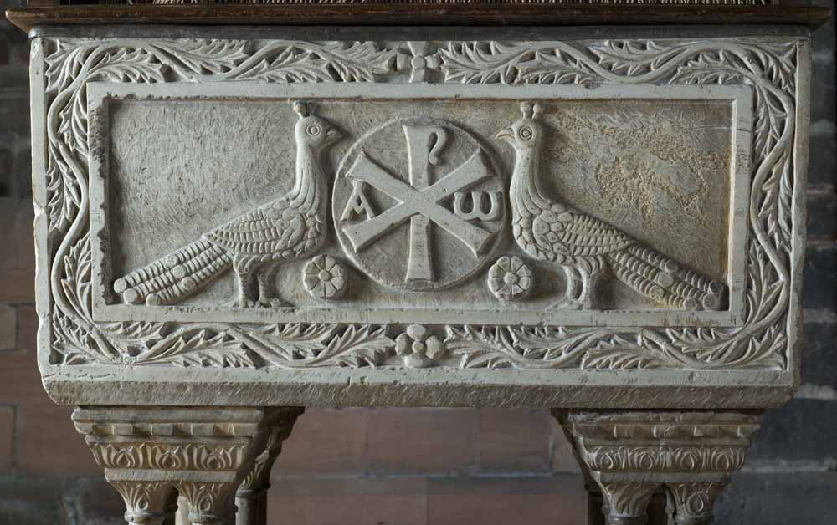
Peacocks on the side of the font
Notes:
Teacher Questions: What can you see in the middle of the picture? What do you think it looks like?
Teachers notes: The A and W are the Greek letter of alpha and omega representing the beginning and the end
The centre are the letters chi (the cross shape) and a Rho (the upright letter) which are the first two letters of Christ

Slide 13
Come and see another font by another door

Slide 14
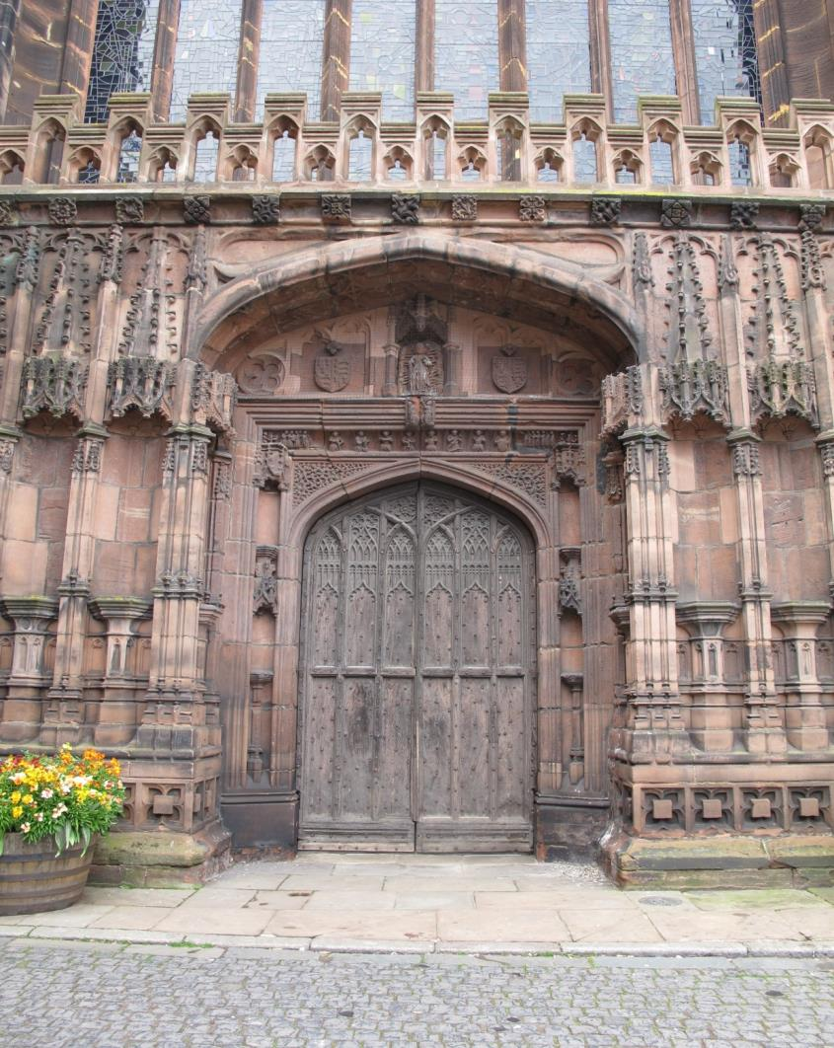
The West Door outside the cathedral
Notes:
This is outside the cathedral. If you go through this door and look to your right this is what you see.
How many arches can you count?

Slide 15
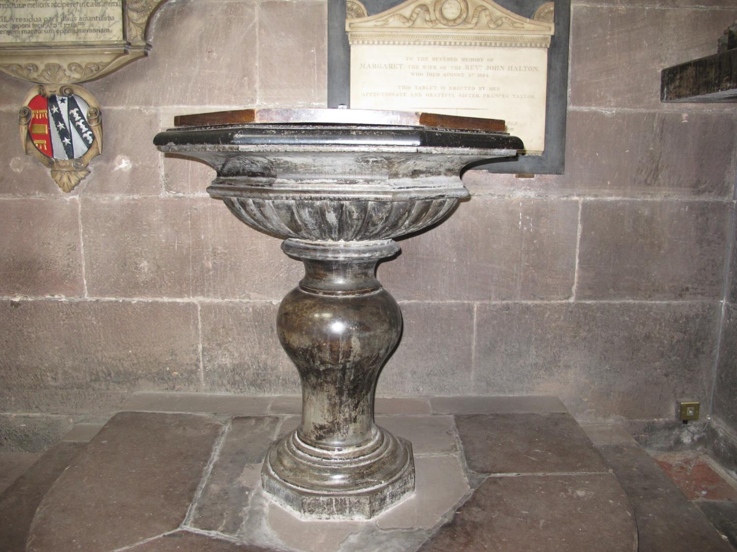
The font inside the West door
Notes:
Teacher Questions: How is this font different from the other font?
Which do you prefer and why?
Why do you think both fonts are by a door? (Baptism is an entrance into being a Christian – like walking through a door)
How are these fonts similar or different from the font in your local church? Do all churches have fonts? Why/Why not?

Slide 16
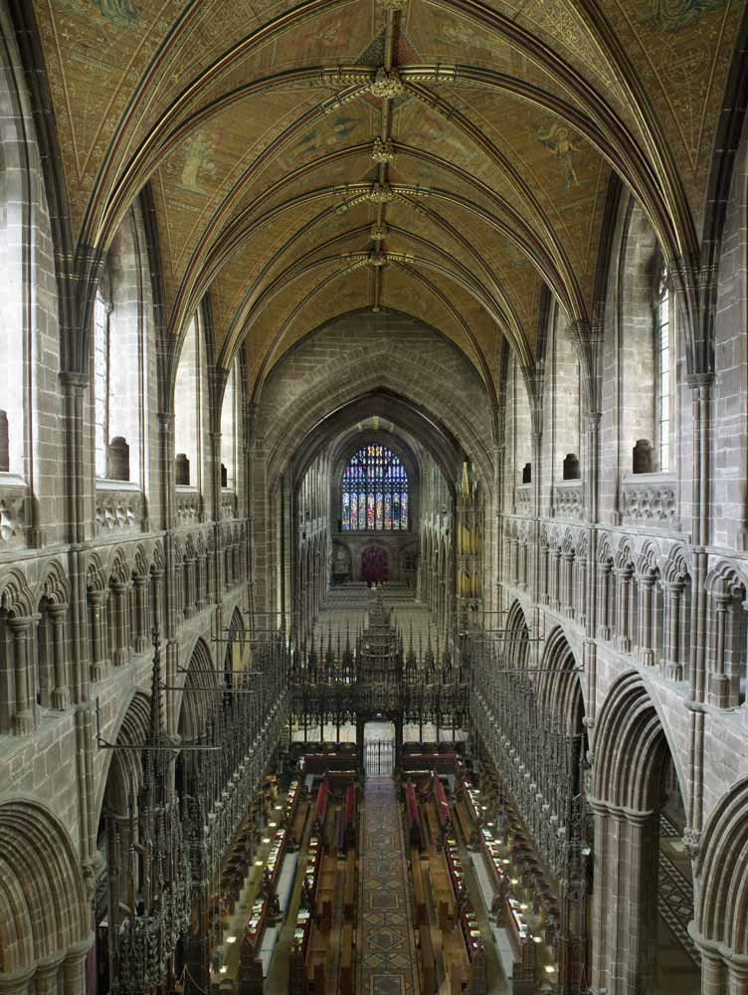
Looking from east to west from above
Notes:
Teacher Note: Looking down at the nave. This is late Gothic architecture
The font you have just seen is at the very end on the left by the doors that now look very small
The cathedral is 38.71 metres high and 113.08 meters long.
Teacher Questions: How long is your school? How high is the roof? How long is your local church? How high is your local church? How much longer and higher is the cathedral than your local church? Why do you think it was built so high?

Slide 17
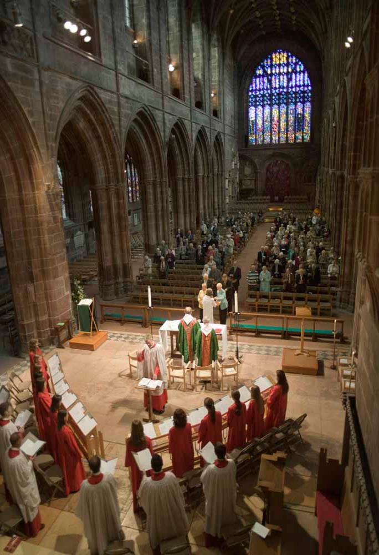
Sunday
Notes:
Teacher Questions: What do you think is happening in this picture?
This is how the cathedral is used every Sunday. Why do people want to worship God?

Slide 18
What’s the story?

Slide 19
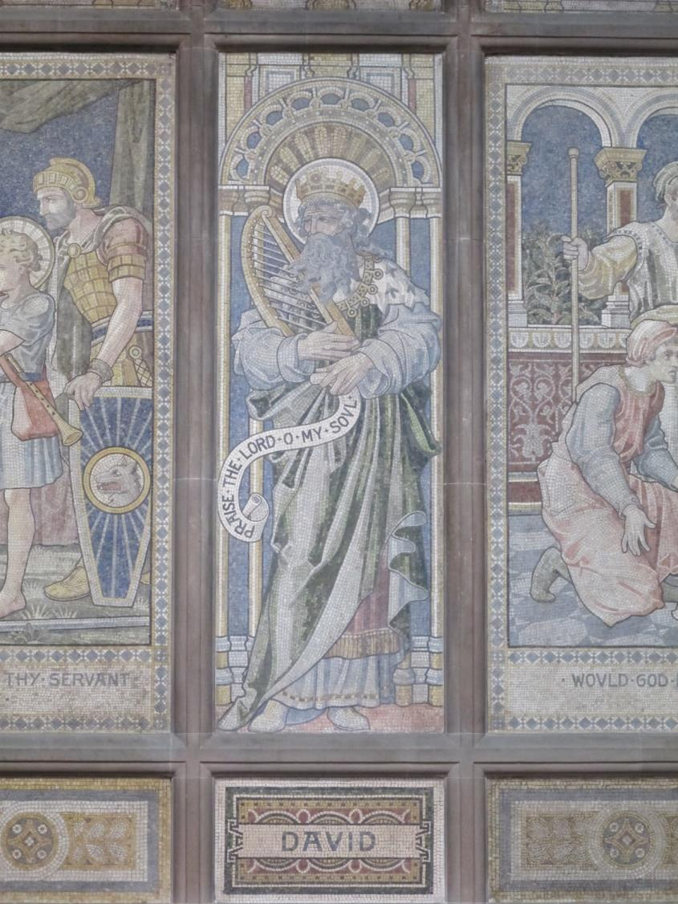
Notes:
Teacher Questions: A mosaic is made up of very small square stones. Can you see the separate pieces?
Who is in the picture?
Where can you read about David? (Old Testament)
What stories do you know about David?
Teacher Note: Mosaics date from 1883-86. Four characters from the Old Testament are shown: Abraham, Moses , David and Elijah. They were designed by John Clayton and are pre-Raphaelite mosaic, made of marble not ceramic tiles. The marble squares are called ‘tesserae’ (linked to the word ‘tessellate’

Slide 20
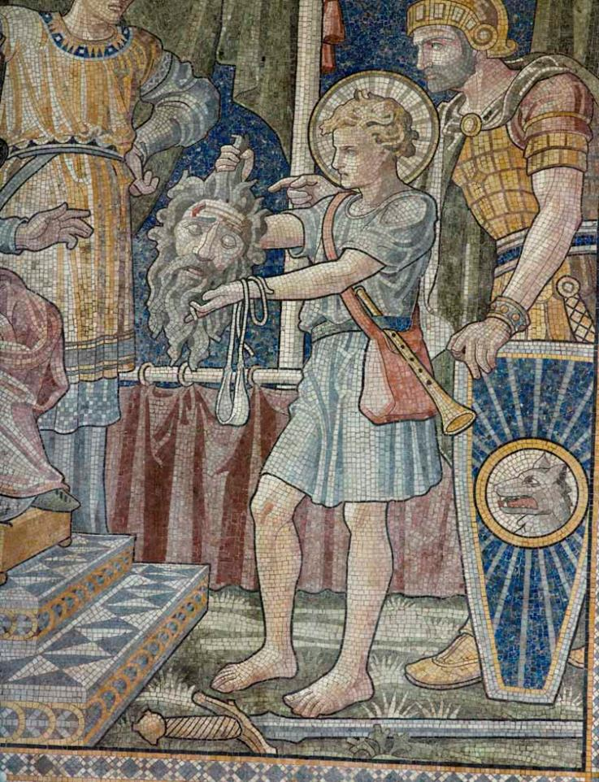
The boy David with Goliath’s head
Notes:
Teacher Question: What was the story of David and Goliath? How did David show he had faith in God

Slide 21
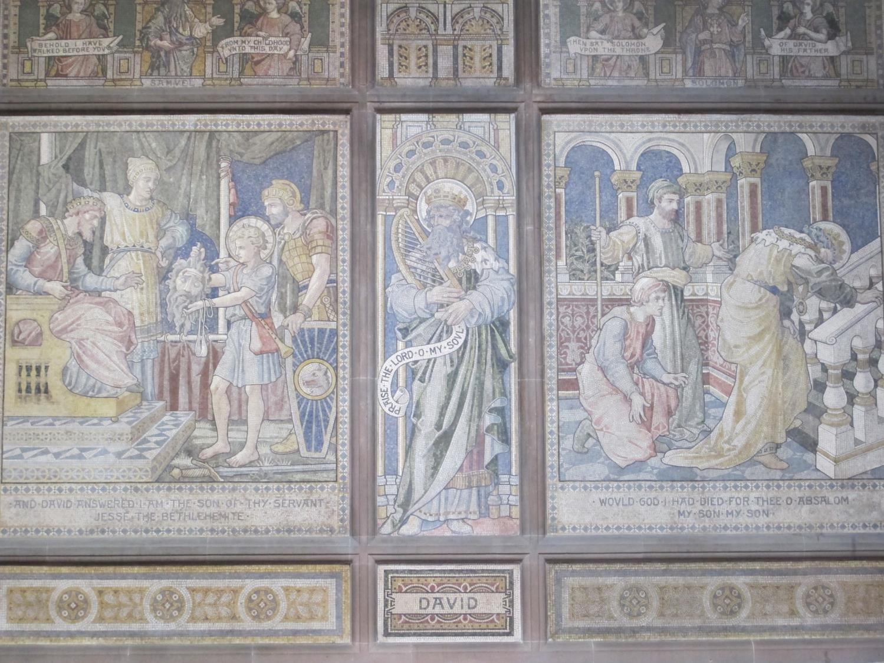
Notes:
Teacher Note: The left hand story is about David as a young boy from the previous slide.
The right hand story is David mourning the death of his son Absalom (2 Samuel 18)
The right hand story tells of the death of Absalom one of David’s sons who fought against David because he wanted to rule. He was killed after being caught in a tree whilst on horseback and one of David’s soldiers found him and killed him. David is weeping in the picture.

Slide 22
The nave

Slide 23
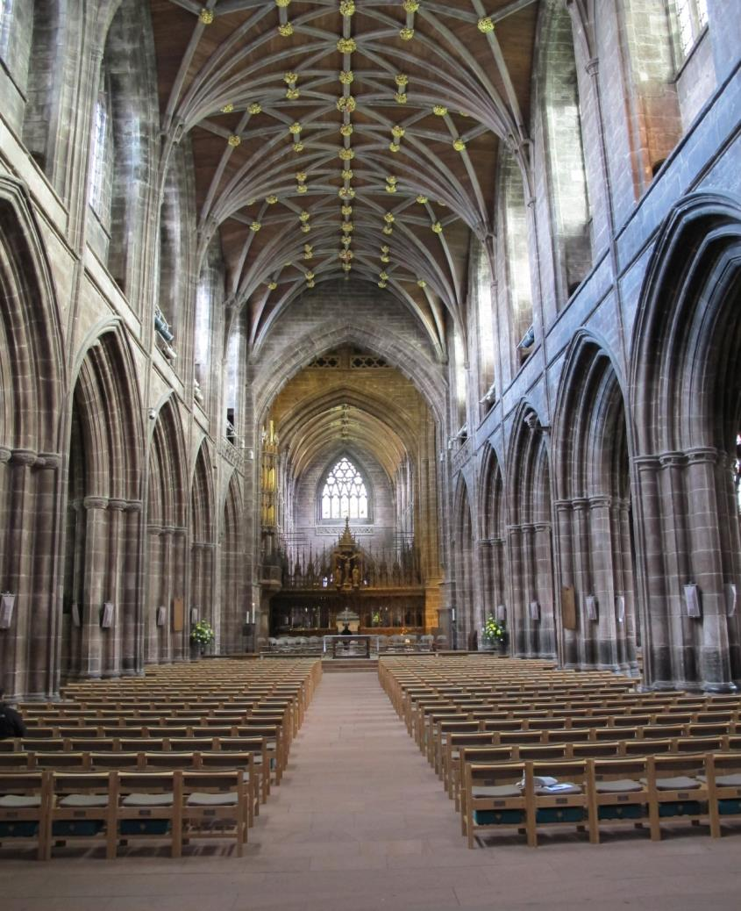
Looking towards the East
Notes:
Teacher Note: The word nave is from the Latin meaning boat. When you look down the nave it is like an ‘upside down’ boat
Teacher Question: Can you see how the roof looks like an upside down boat? Make the shape in the air with your hand.
The space between the chairs is called the aisle.
How does this look similar to your local church?
What shape are the arches?
Walk to the very end of this nave and you find a plain altar.
Note: it was begun in about 1360 but delayed due to the Black Death

Slide 24
The Chester Imp in chains
This imp is far out of sight high up on a pillar in the left of the previous picture.
The story is that a monk walking along the top
of the gallery thought he saw the devil looking in through the window and told the abbot. The abbot had the carving made of a devil in chains to warn the devil he would be put in chains if he dared to return.

Slide 25
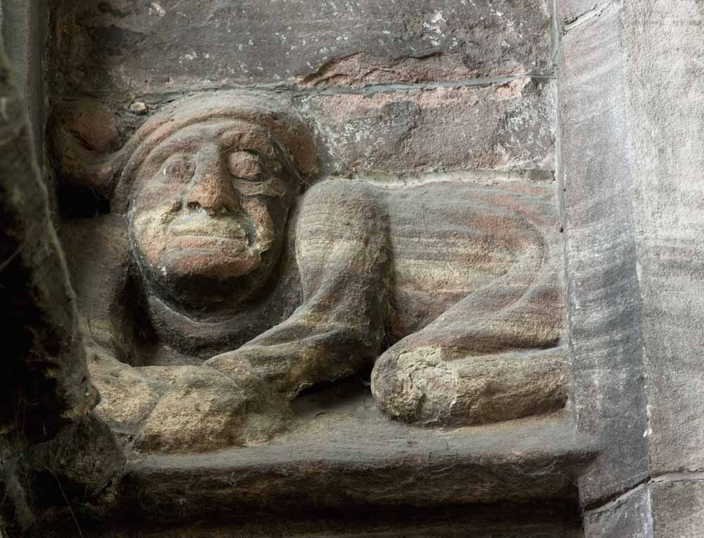
Notes:
Teacher Questions: What frightens you? What do you do to stop yourself being scared?

Slide 26
The altar

Slide 27
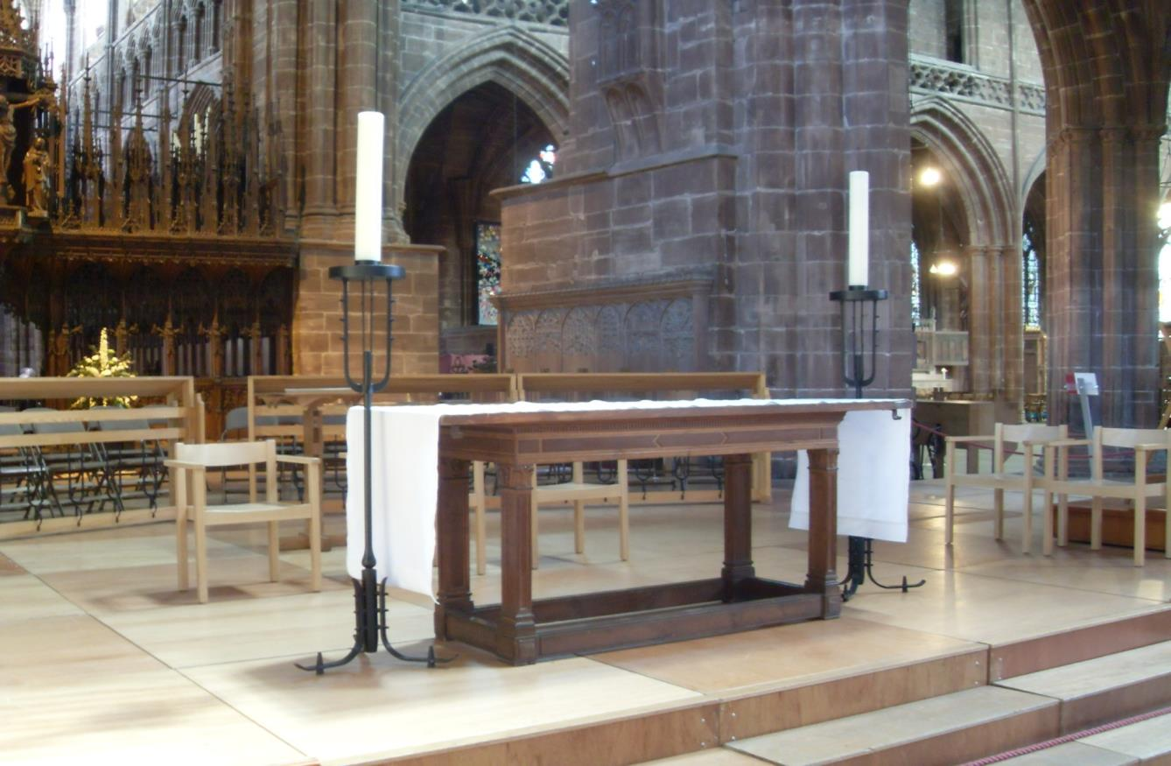
Notes:
Teacher Questions: What do you think this is used for?
Teacher Notes: The altar is used to place bread, wine, prayer books and the bible reading on. It is a modern table.

Slide 28
Music
The organ plays hymns during the service. It is also played sometimes as a solo instrument during a service.

Slide 29
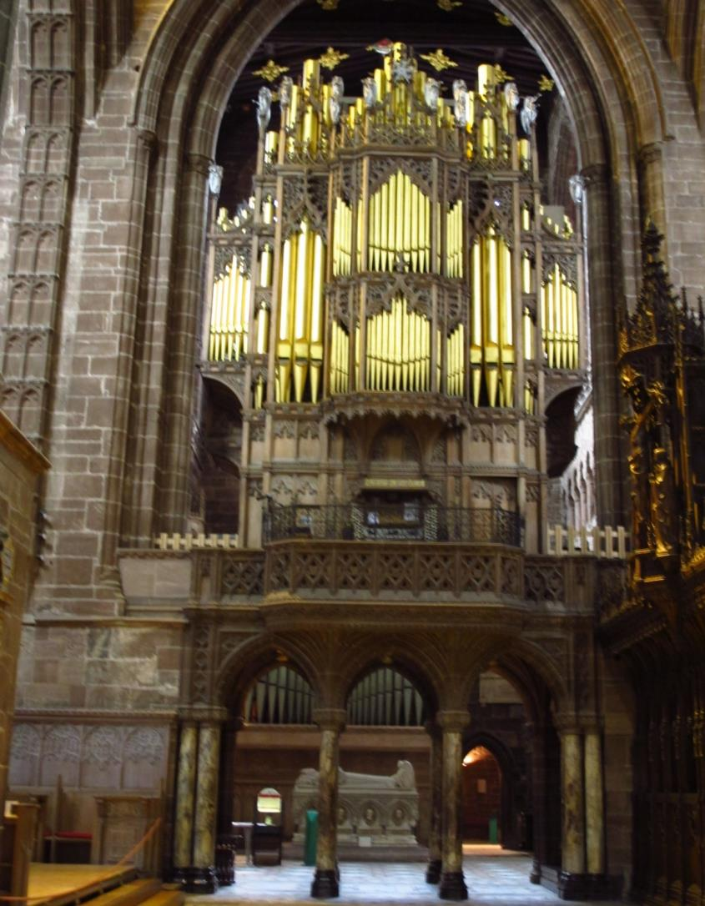
Notes:
Teacher Questions
Why do you think the golden organ pipes are of different length?
How is music made in your local church?
Teacher Notes: There are 4864 pipes

Slide 30
Worship

Slide 31
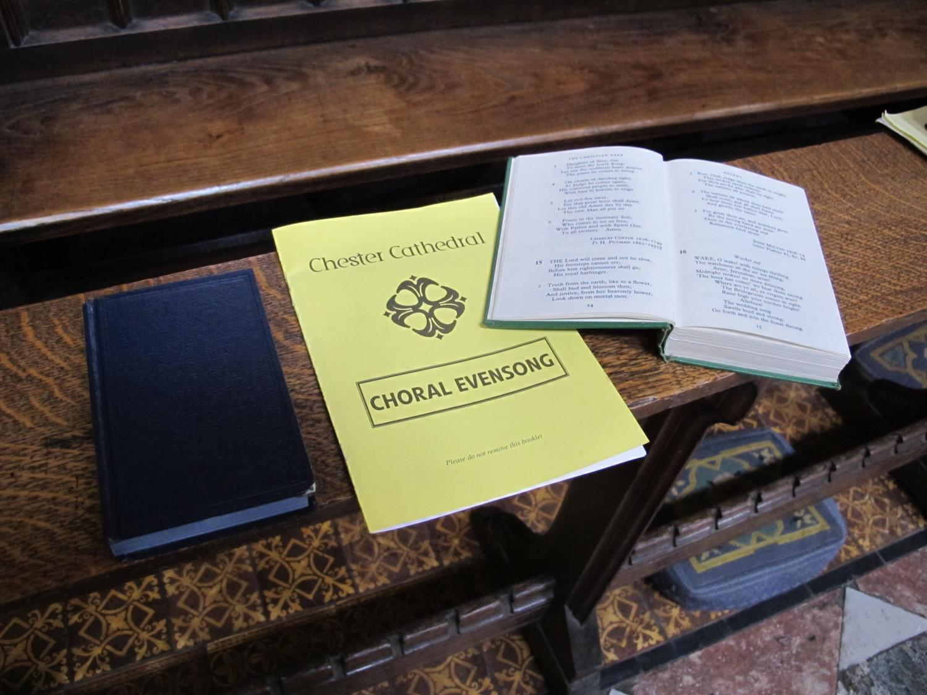
Notes:
Teacher Questions: What do you think these are used for? How are these similar or different to those in your local church?
(The people use books to read prayers from and hymn books to sing)

Slide 32
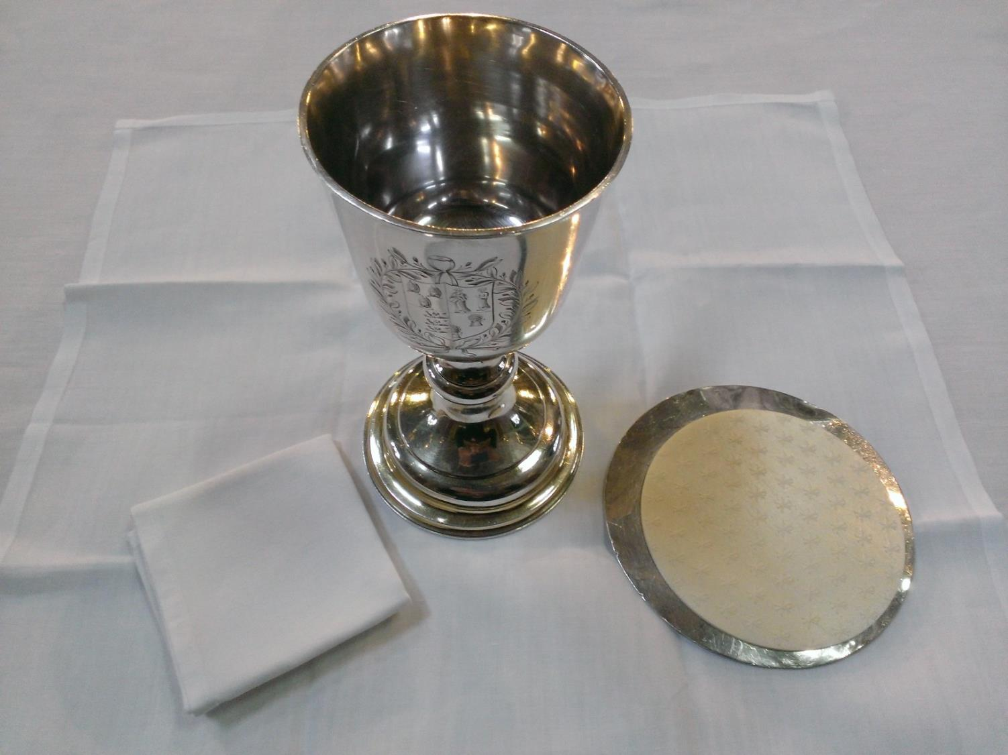
Notes:
Teacher Questions: What can you see?
What do you think they are used for? Why? What is used in your local church? How are they similar/different?
Teachers note The wafer is the priest wafer for Holy Communion and is on a paten (silver plate). The cup holds wine for Holy Communion and the cloth (a purificator) is used to dry the cup as people drink from it

Slide 33
The lectern

Slide 34
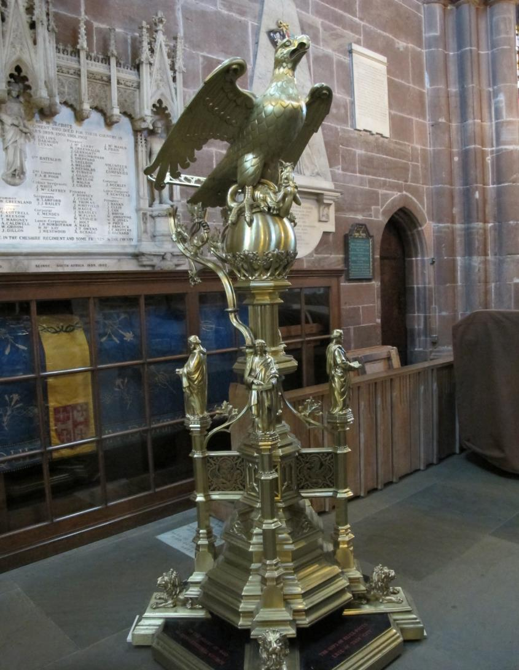
Notes:
Teacher Questions: What do you think this is used for?
What bird would you choose to hold the Bible while it was read in a service?
Who do you think the people are? (4 gospel writers)
How is this similar or different from the lectern in your local church?
Teacher note: A lectern sometimes has an eagle.
It represents St John, the eagle and also the word of God flying out over the world into people’s hearts and minds.
This brass lectern is no longer used.

Slide 35
Come into the Quire

Slide 36
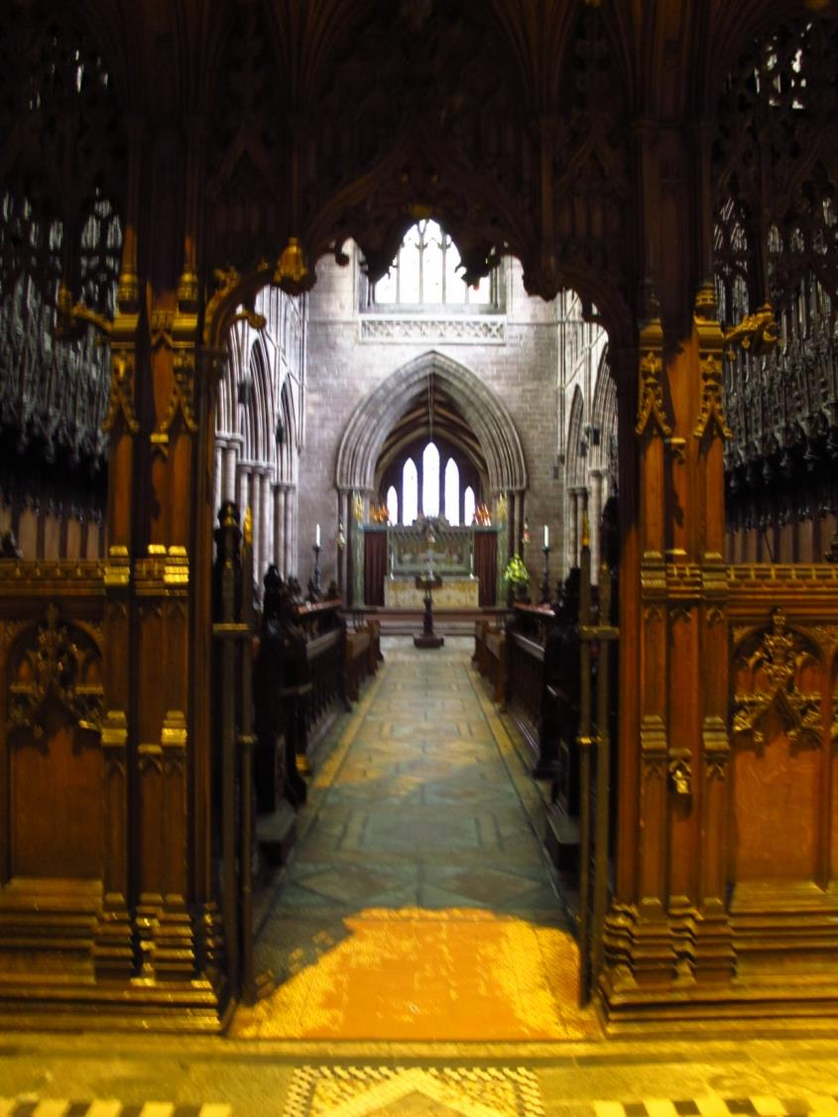
Going into the Quire
Notes:
As you walk through this gateway, you can look down towards the high altar
Can you see the altar and lectern in the distance?

Slide 37
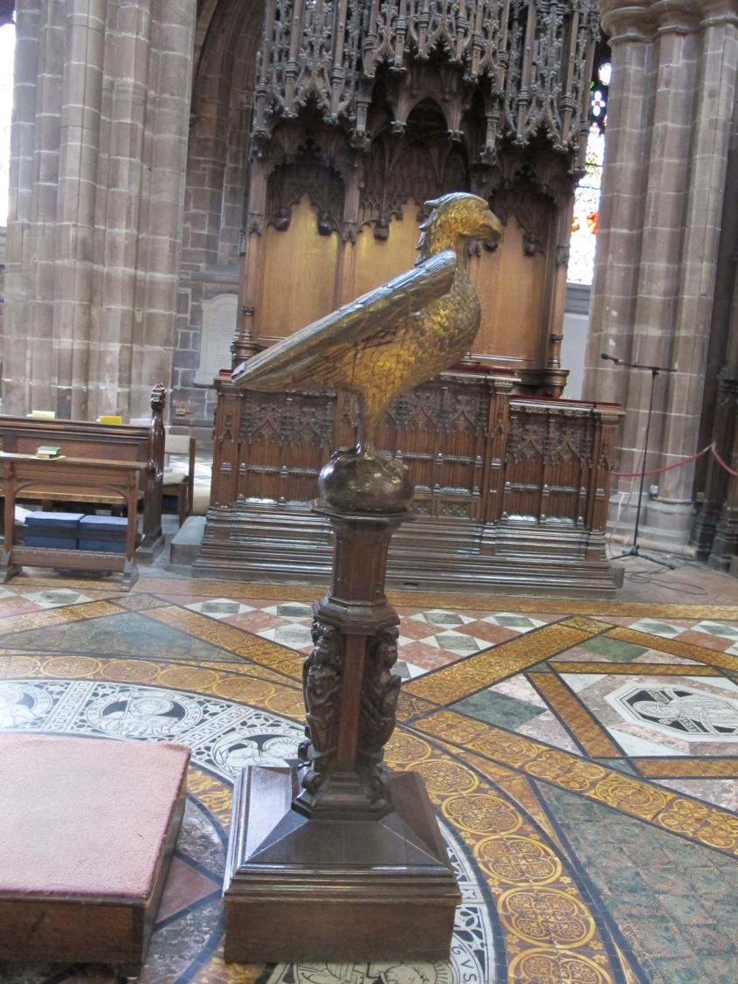
Notes:
Teacher Notes: This wooden lectern is used in the Quire

Slide 38
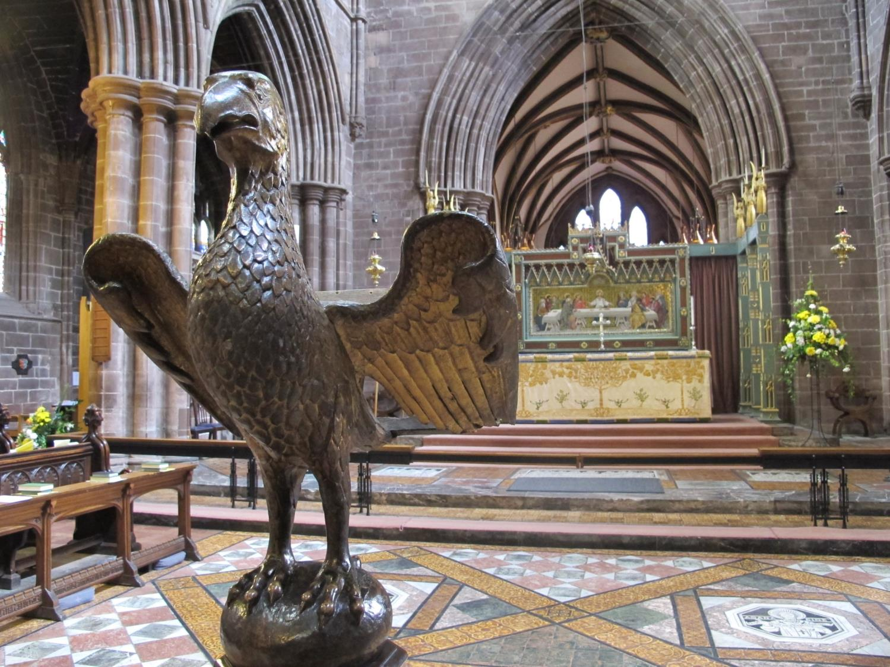
Notes:
Teacher Question: What can you see behind the lectern? (The high altar) What else can you see?

Slide 39
Where the people sit in the Quire

Slide 40
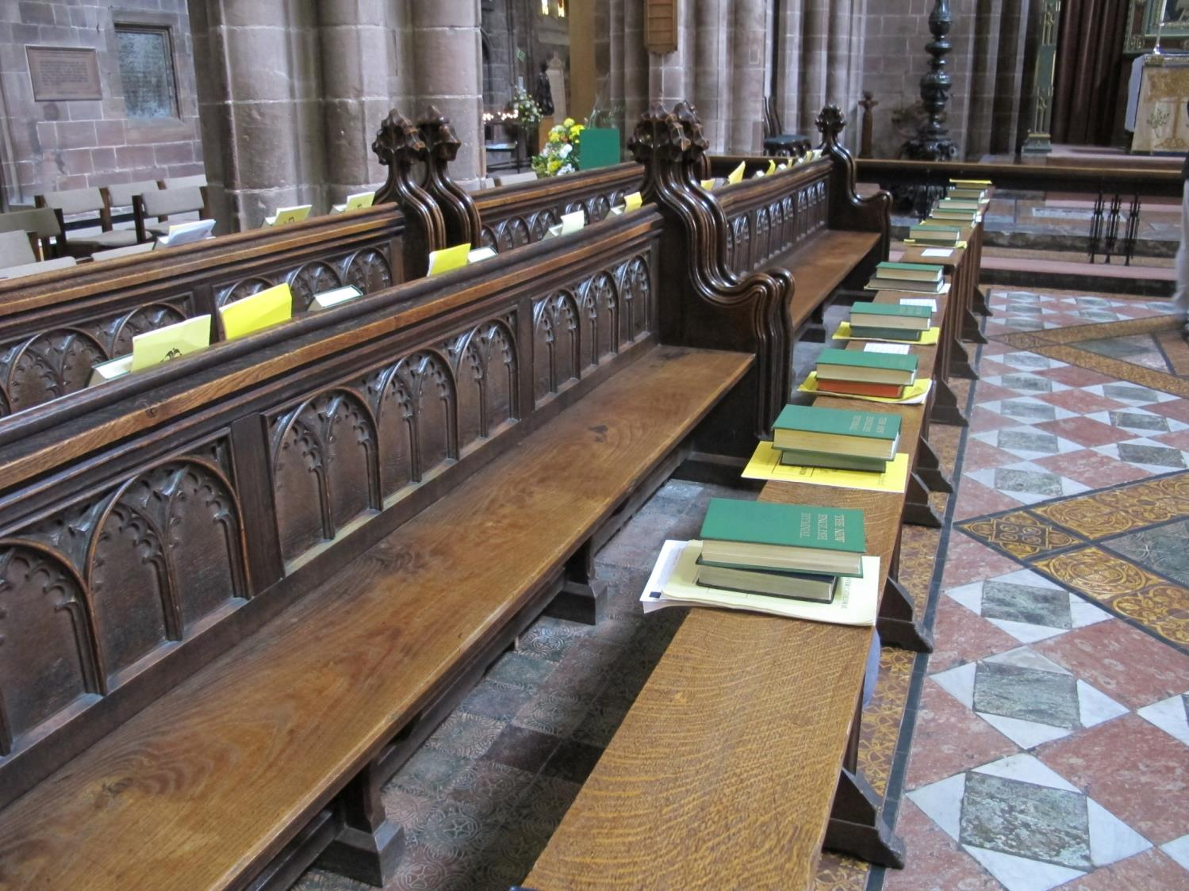
Notes:
Teacher Notes:
People sit on long wooden seats on either side of this lectern
What books can you see?

Slide 41
Look up

Slide 42
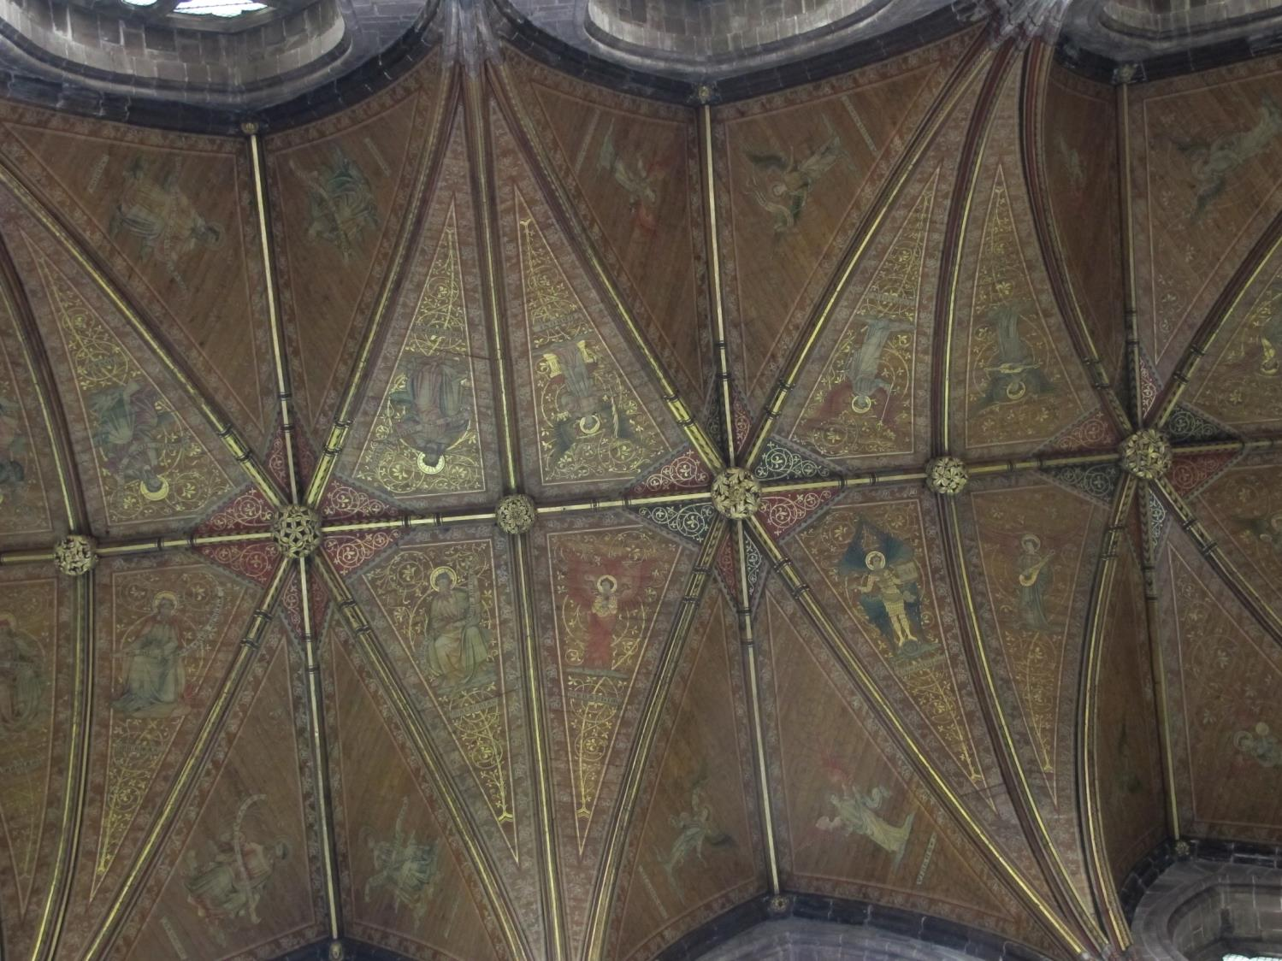
Notes:
Teacher Questions: What do you think this roof is made out of? What can you see? What would you paint on a roof of a church if you were an artist?
Teacher Note: The roof is made of wood and painted gold.

Slide 43
The High Altar

Slide 44
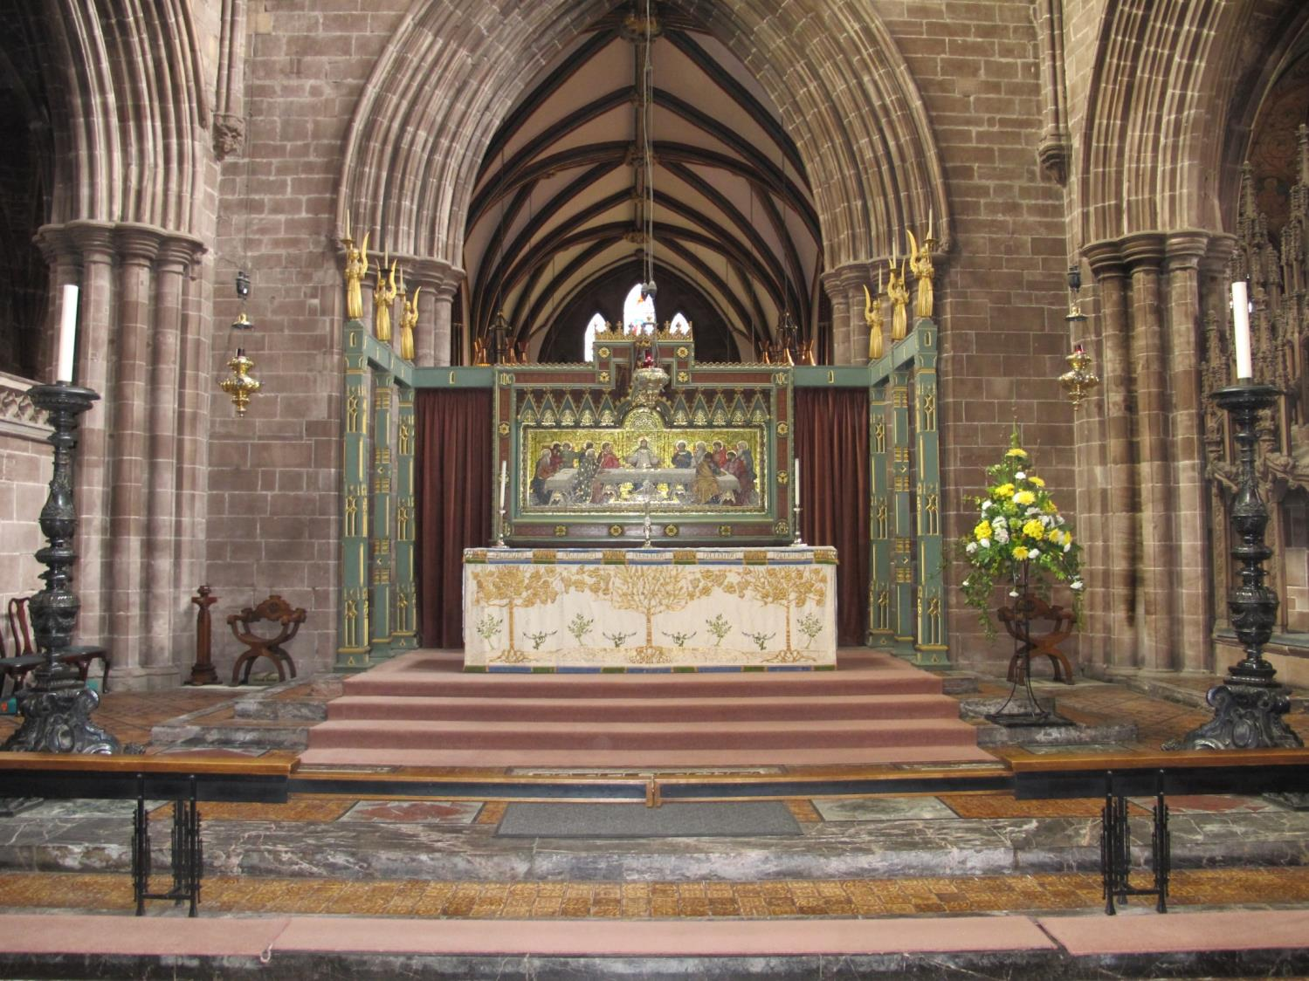
Notes:
Teacher Notes: There is more than one altar in the cathedral. This one is in the Quire behind the wooden lectern.
Teacher Questions: How many steps can you see? What else can you see? Why do you think it is called the High Altar?

Slide 45
Above and behind the altar
Look at the next two pictures
This is another mosaic

Slide 46
The High Altar

Slide 47
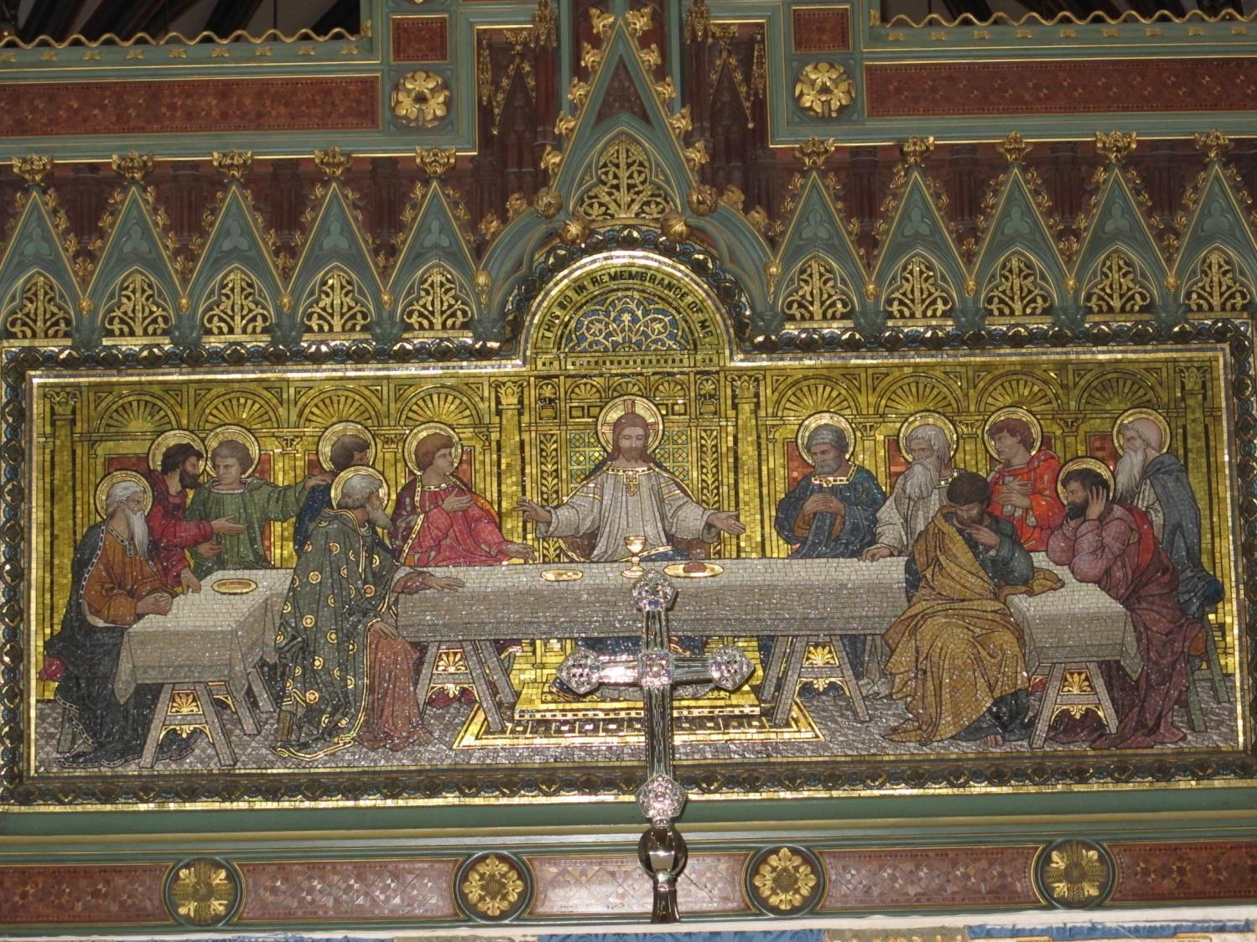
Notes:
Teacher Questions: What story do you think the picture tells? (The Last Supper)
What do you think Jesus is saying?
Which one do you think is Judas? (The one without a halo)

Slide 48
The cathedra

Slide 49
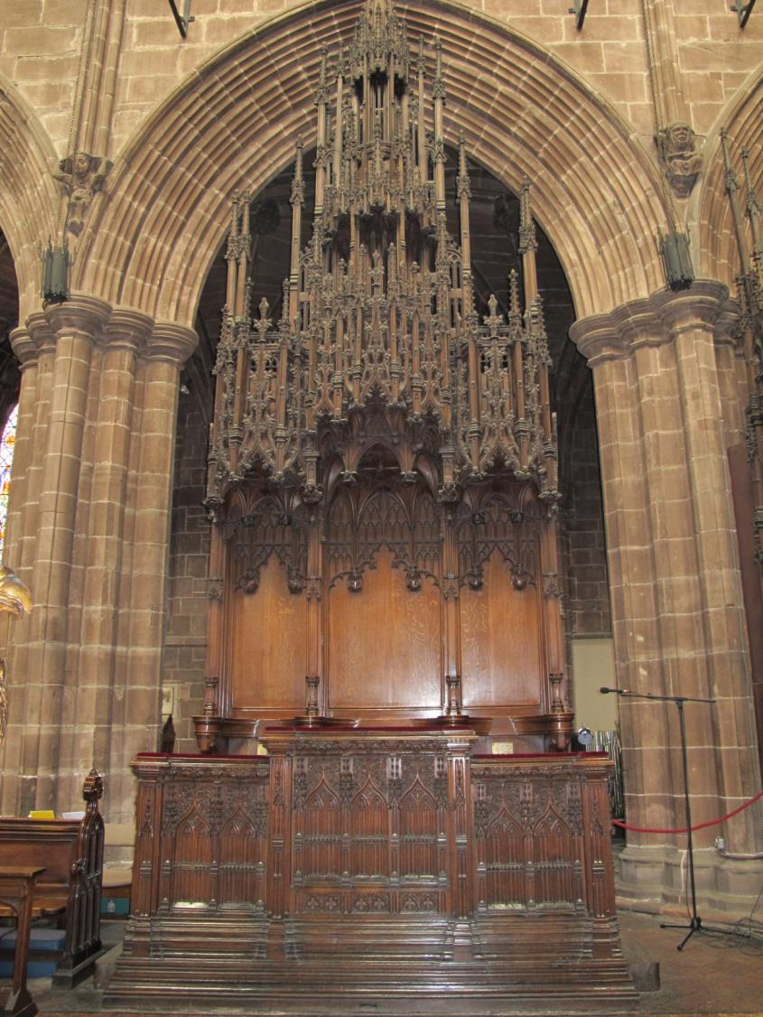
The Cathedra
Notes:
Teacher notes: This is where the Bishop sits – the cathedra means teacher’s seat
Teacher Questions:
Are there any special chairs in your local church? What do they look like? Who sits there?
How is similar or different from your teacher’s chair?

Slide 50
Standing during services
Monks had to stand for a long time during the services, so they got tired. They could lean against wooden seats with designs on the back called misericords.

Slide 51
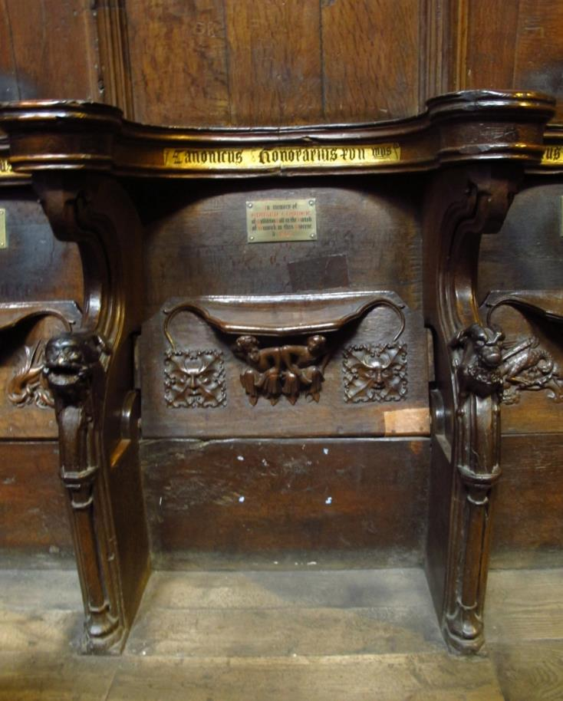
A misericord on the back of the seat
Notes:
Teacher Notes: Here the seat is up. The shelf can be seen where the monks perched. These were constructed around 1380.

Slide 52
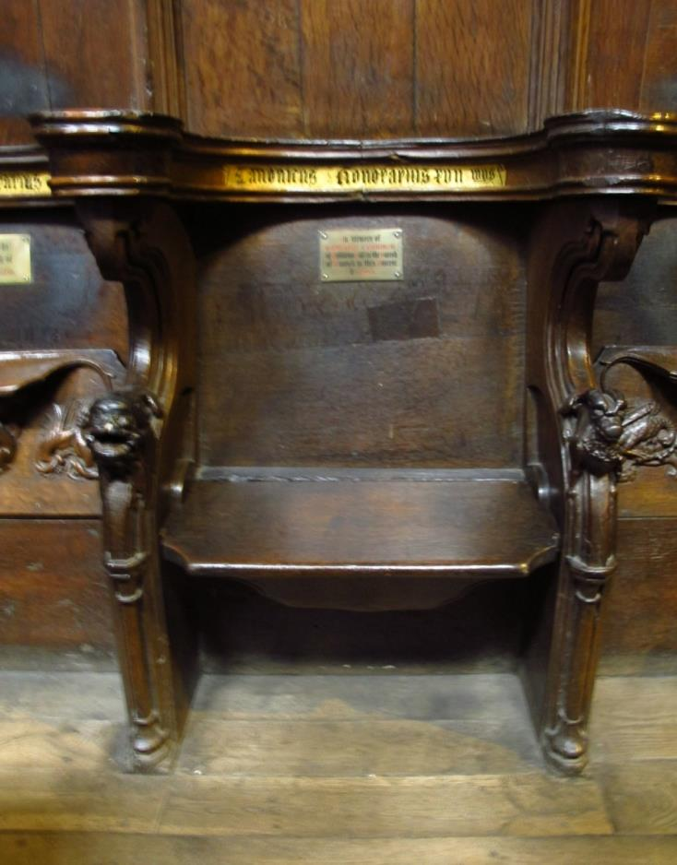
The misericord is now hidden
Notes:
Teacher Notes: This is with the set down ready for sitting on

Slide 53
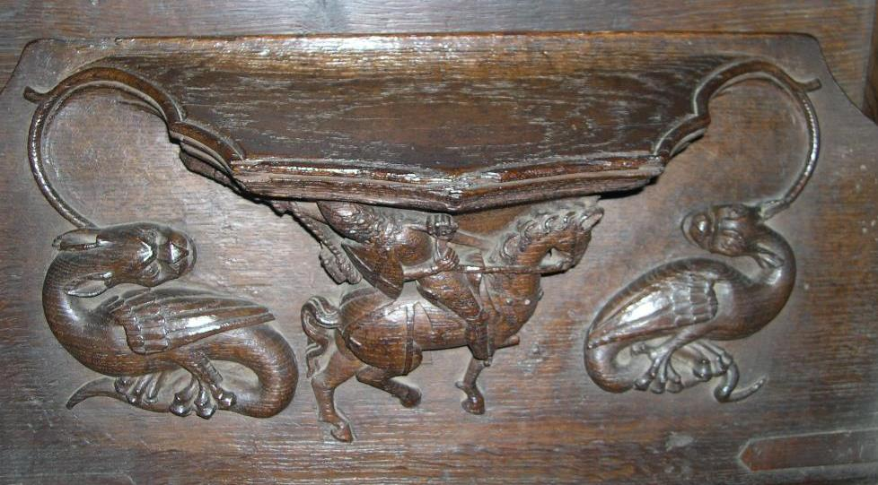
Notes:
Teacher Question: There are often beautiful carvings.
What do you think this carving is about?
A knight falling off his horse: ‘Pride comes before a Fall’. What does that mean? Can you think of times when you have experienced ‘pride coming before a fall’.
What animals can you see?

Slide 54
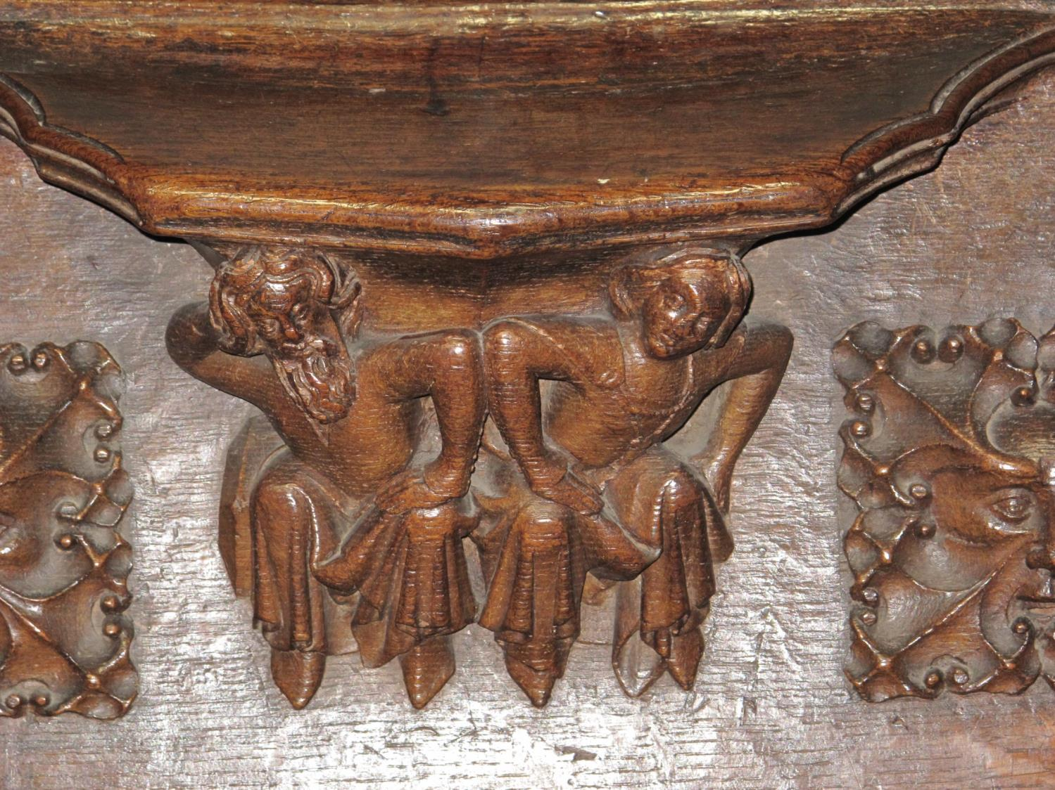
Notes:
Teacher Questions
What do you think these people doing?
What would you have carved under the seat?
Teacher’s notes
The couple may be having an argument (sin of Wrath) or going to the lavatory, which warded away evil spirits by repelling something horrible.

Slide 55
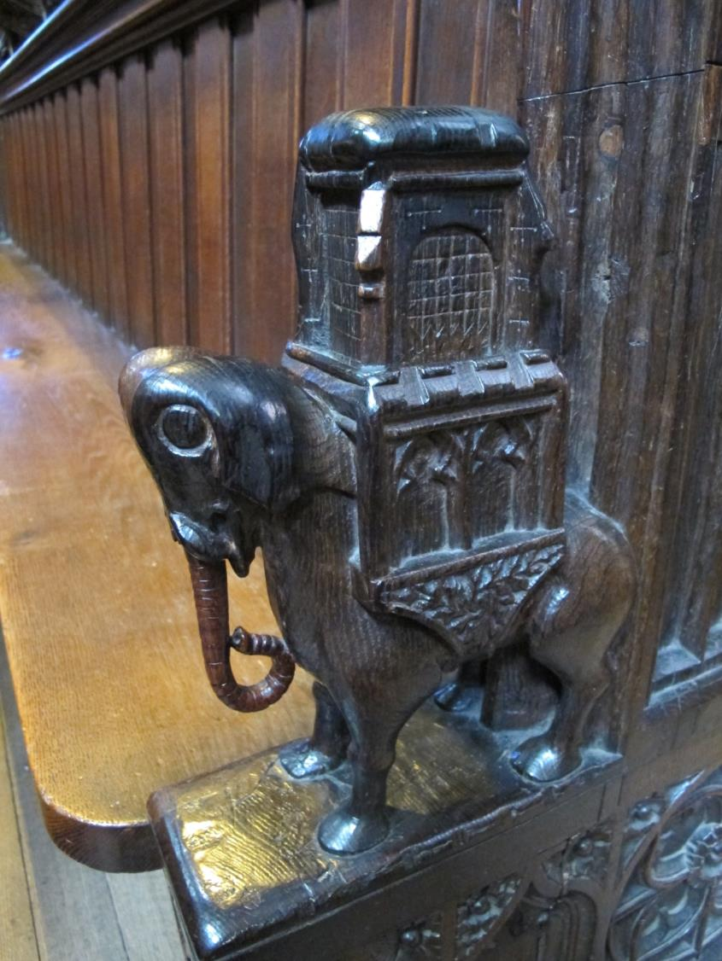
The elephant
Notes:
Teacher Questions: This carved elephant is at the end of a pew. What do you notice about his feet?
The carver only saw the top of an elephant and didn’t know what it looked like, so it has horses hooves!

Slide 56
Prayer

Slide 57
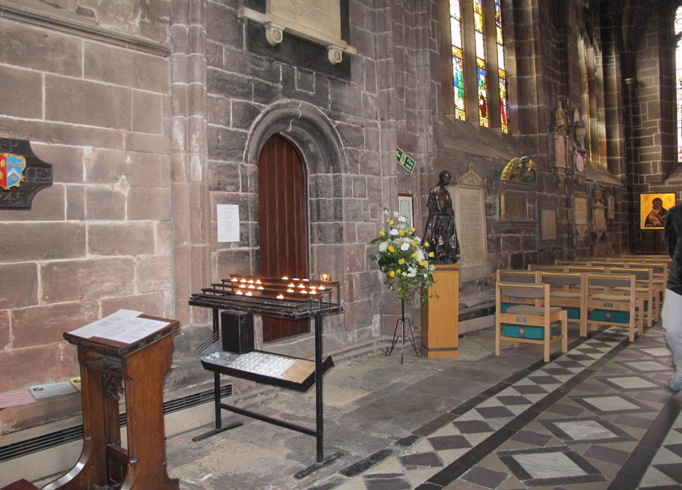
Notes:
Teacher Notes: Anyone can come and say and a prayer in the cathedral. They can light a candle for the person for whom they have prayed. The candles are called votive candles.
Teacher Questions: How do you know people pray in the church nearest to you?

Slide 58
Saying a prayer
Notes:
Teacher Questions: How many prayers do we know have been said on this day?

Slide 59
Nativity Window
This window is straight in front of the votive candles.

Slide 60
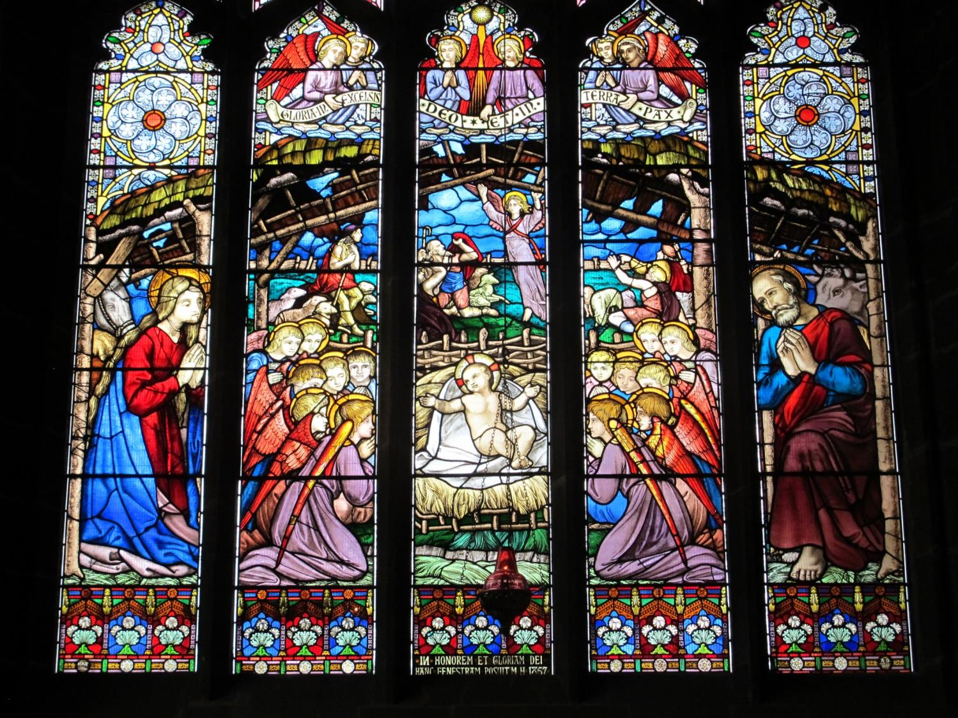
Notes:
Teacher Questions: Why do you think it is called the nativity window? Who can you see ?

Slide 61
The Lady Chapel
By the Nativity window is the Lady Chapel where there is a statue of St Werburgh.
St Werburgh is the saint associated with the Cathedral.

Slide 62
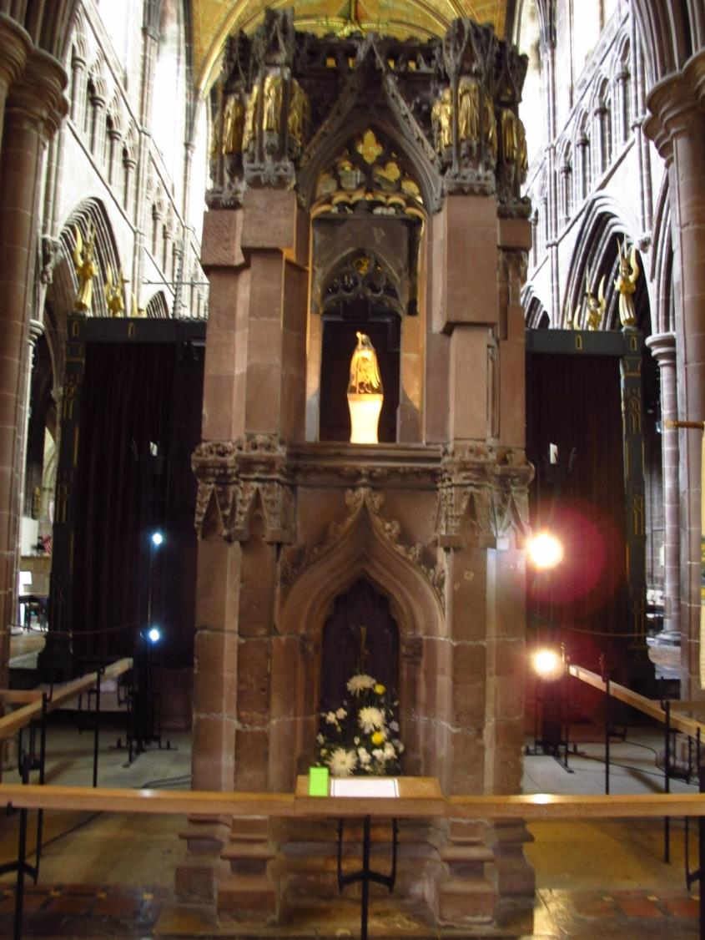
Notes:
Teacher Notes: St Werburgh is the small figure raised up in the middle, on the small stone column
Teacher Question: Why do you think she is so high?

Slide 63
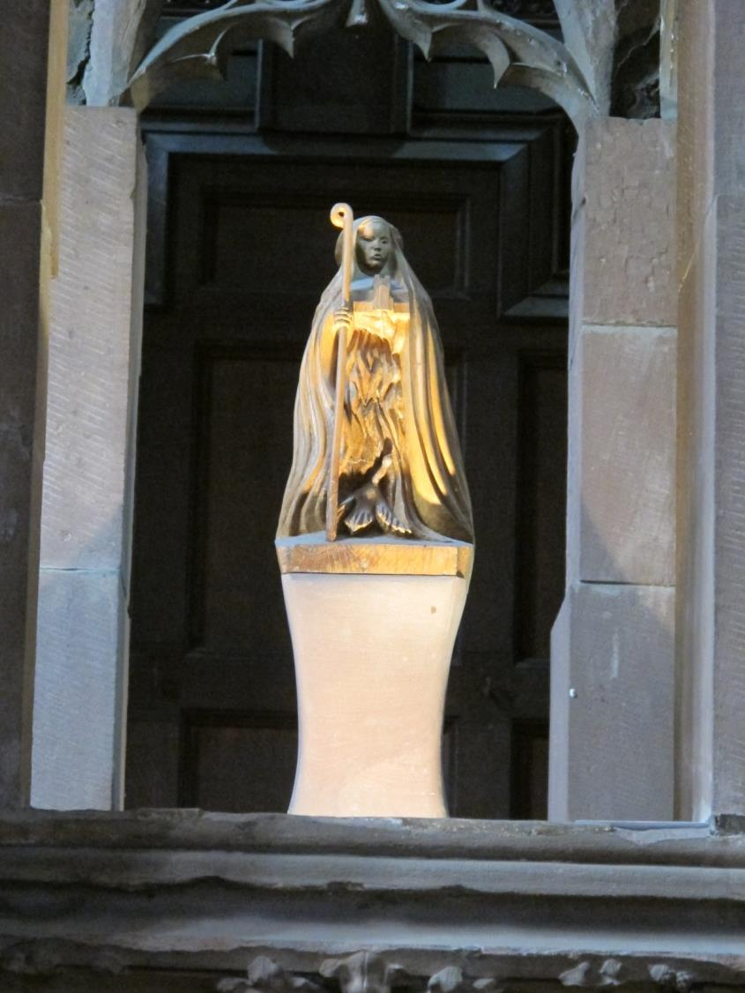
St Werburgh
Notes:
Teacher notes: A close up of St Werburgh
The life of St Werburgh
We know little of Werburgh’s life. Born in c650AD probably in Stone, Staffordshire, she may have been educated in East Anglia, although some women in her family were brought up in French nunneries in Chelles and Farmoutiers. She took the veil under her great-aunt Etheldreda at Ely, and she is recorded as the 4th Abbess of Ely after her mother, grandmother and great aunt. At the same time her uncle Ethelred had put her in charge of double monasteries at Three kingham, Weedon and Hanbury. She is portrayed as a model nun and a good supervisor, who had healing and calming powers. Her best known miracle records that when she discovered that a servant had killed a goose to eat it, she brought it alive again. Another is that she was able to dissuade geese from feeding on the local fields at Weedon and drove them from the area.
Teacher Question: Is you local church associated with a saint? What do you know about that saint?

Slide 64
St Werburgh
There is a tiny dog on the side of St Werburgh’s Shrine

Slide 65
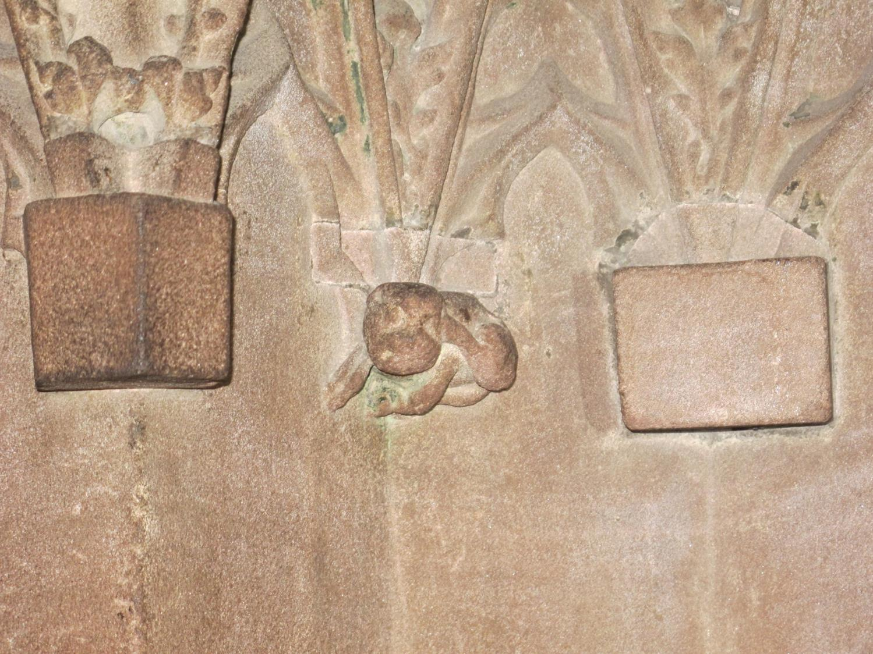
Notes:
Teacher Questions: Why do you think the sculptor carved a dog? Note: we don’t know the answer…it could be to show that everything had a place in God’s house.
The dog is scratching his ear with the back of his leg. What animal would you have carved on the side of the shrine?

Slide 66
St Werburgh
Here is St Werburgh in the West window. She is in the last panel on the left

Slide 67
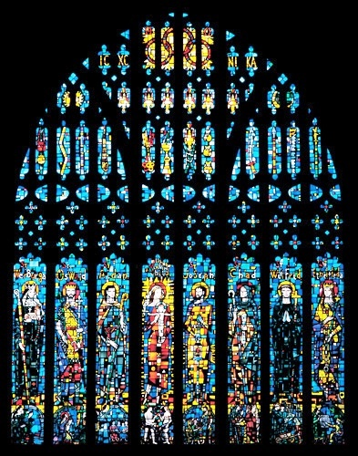
The West Window

Slide 68
St Werburgh
One panel of the West Window
Notes:
Teacher Notes: The spelling of St Werburgh’s name can vary

Slide 69
Crosses
There are many kinds of crosses in the cathedral. How are these crosses different or similar from those in your local church?

Slide 70
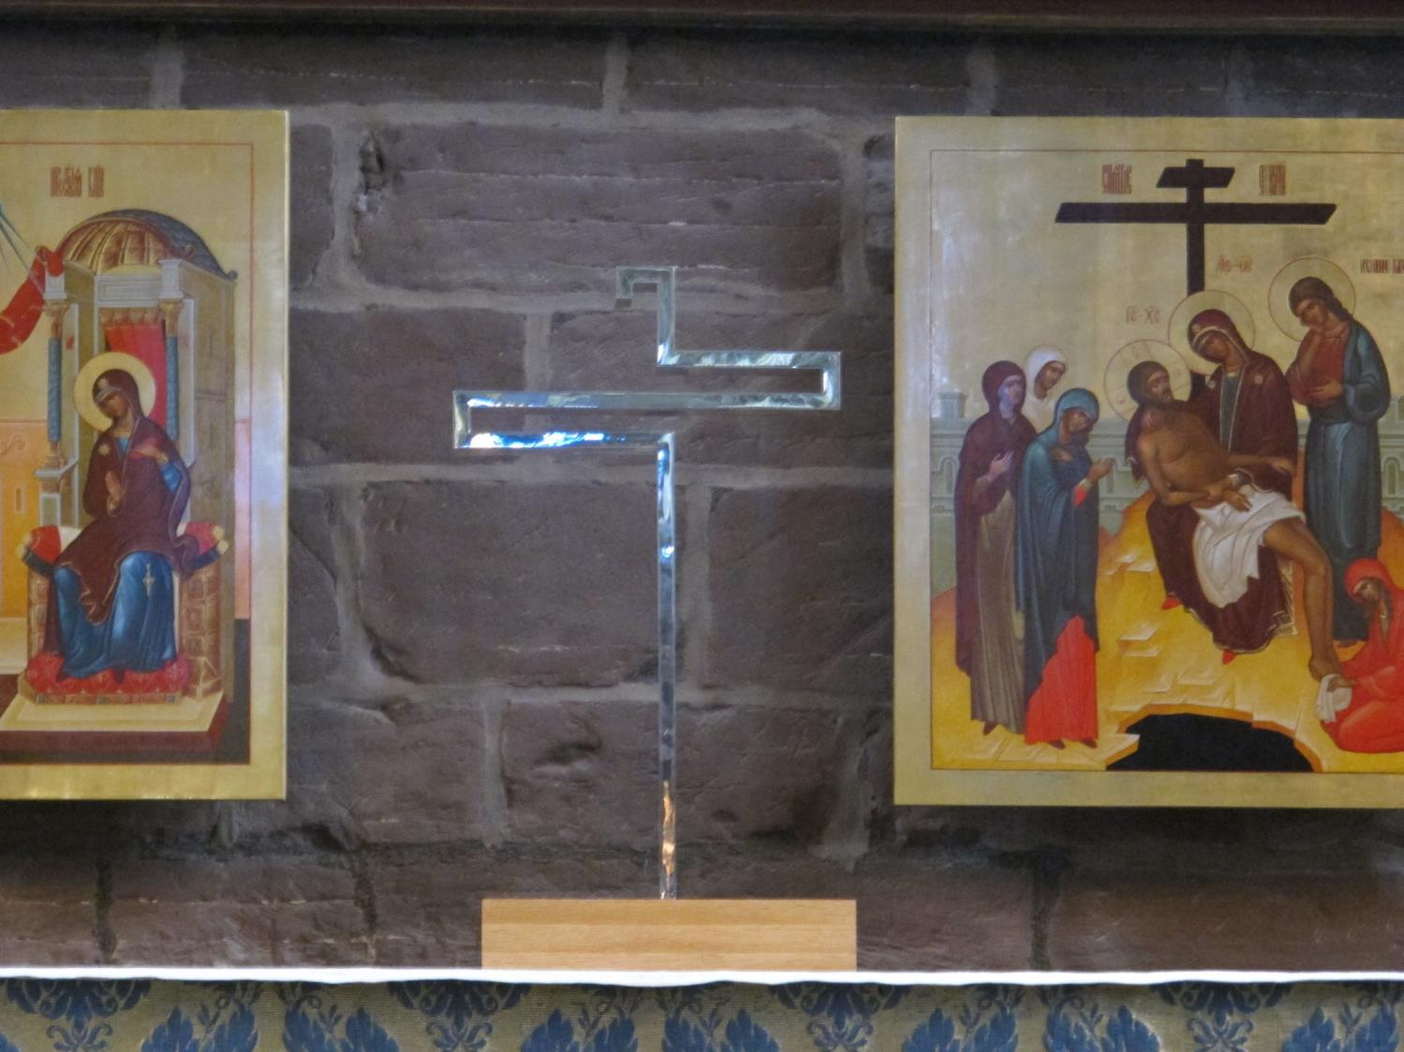
The cross on the Altar in the Lady Chapel

Slide 71
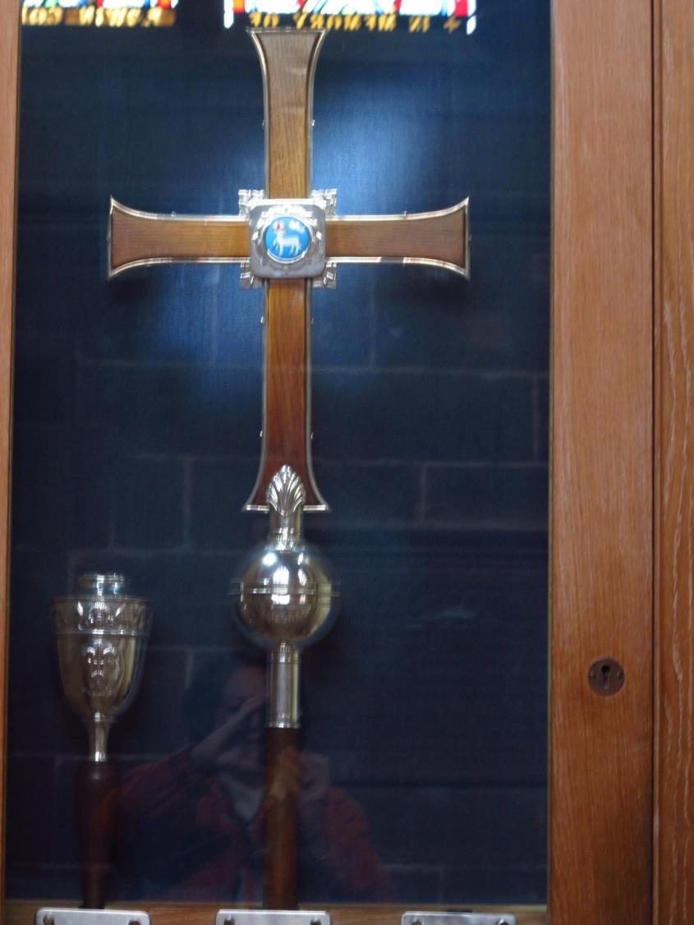
Notes:
Teacher note: This cross is carried in processions

Slide 72
Cross on the high altar

Slide 73
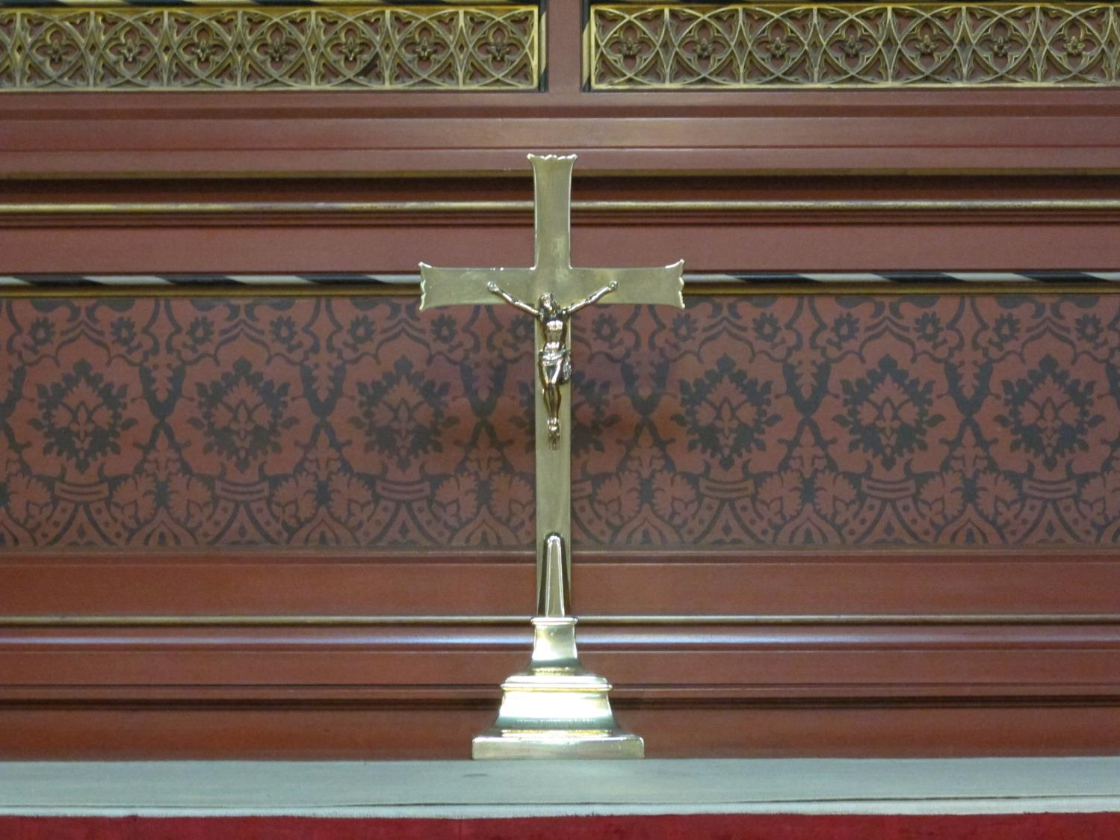
Notes:
A cross on a side altar

Slide 74
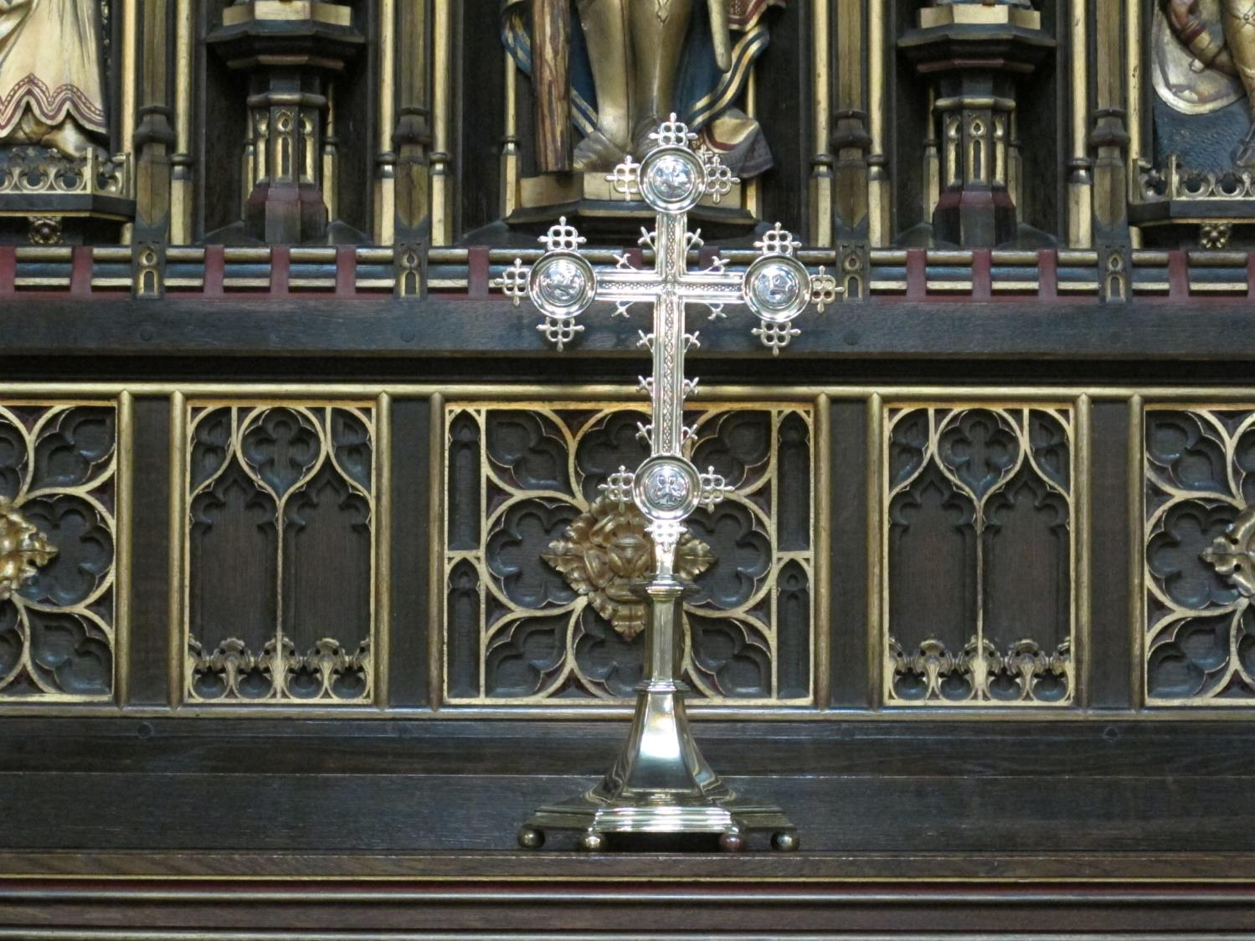
Notes:
A cross on a side altar

Slide 75
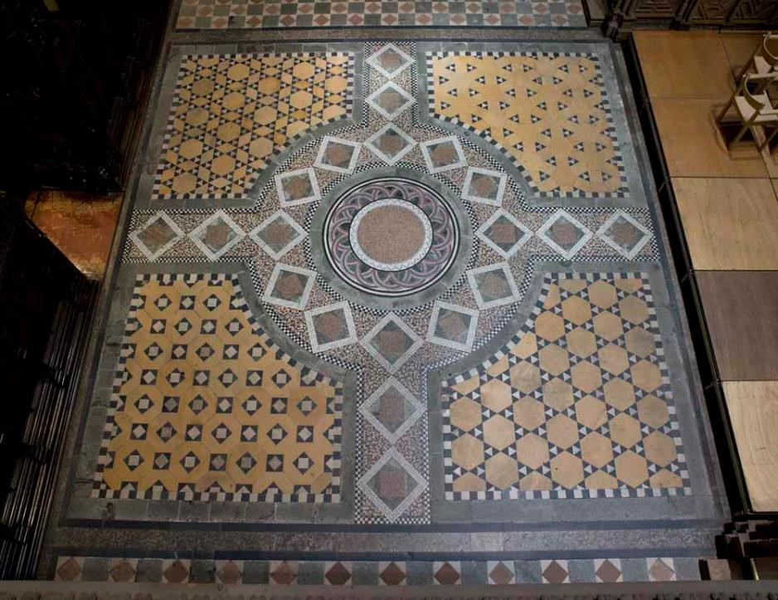
Mosaic cross on the floor

Slide 76
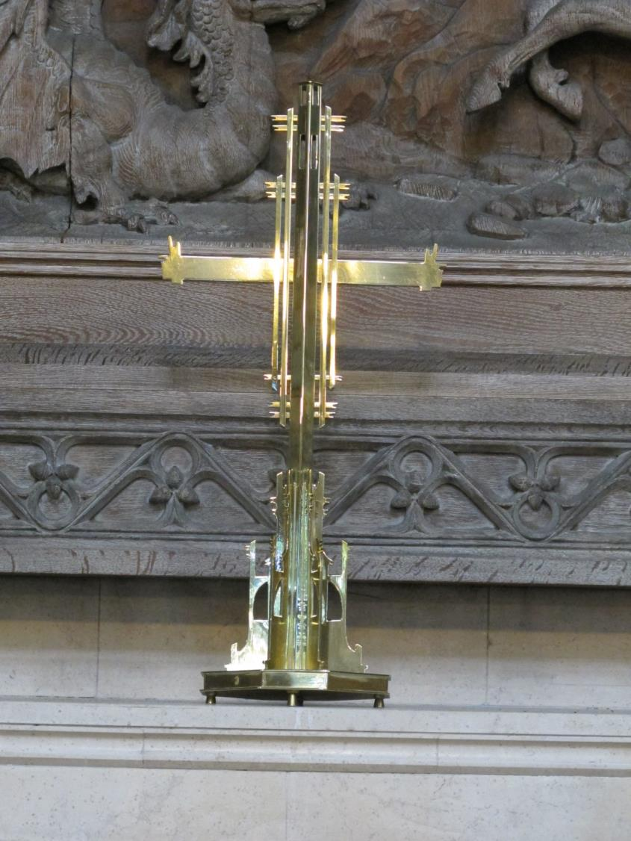
Notes:
Cross on a side altar

Slide 77
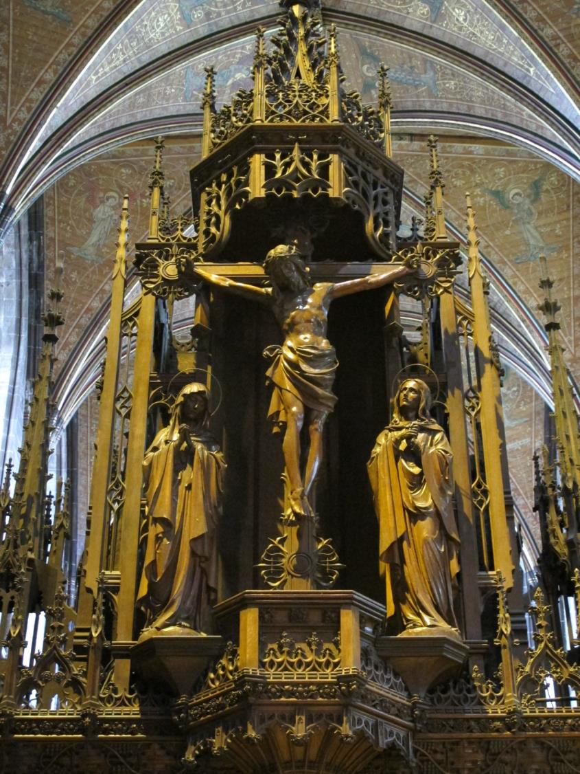
Notes:
Teacher note: Wooden crucifix on the rood screen
Who do you think is standing next to the cross?
What is this cross made from? (Wood)

Slide 78
The Monks

Slide 79
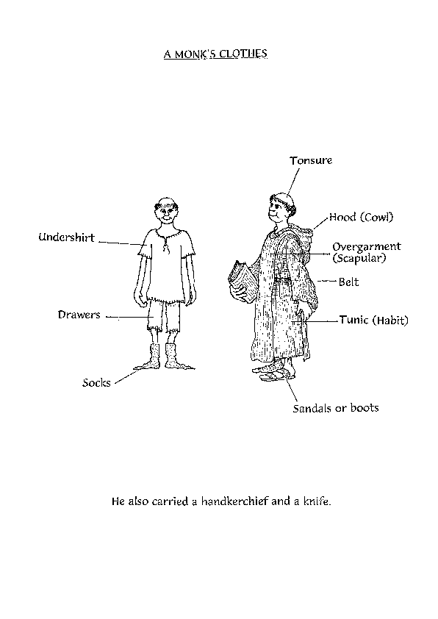
A monks clothing
Notes:
Teacher Questions: How is a monk dressed differently from you?

Slide 80
Where the monks met

Slide 81
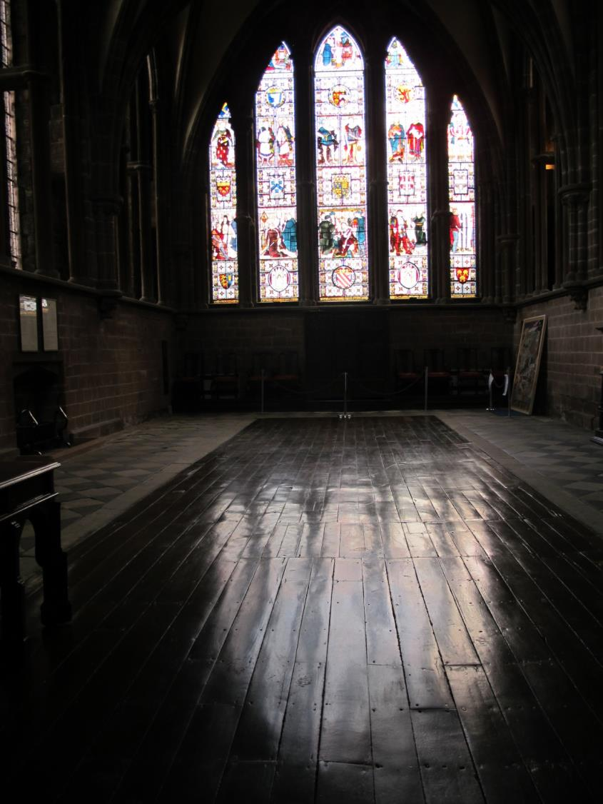
The Chapter House
Notes:
Teacher Notes: The monks met in this room called a Chapter House
They discussed the rules of the house and made decisions. The rules were set out by St Benedict: the monks were called Benedictine monks.

Slide 82
Where the monks wrote

Slide 83
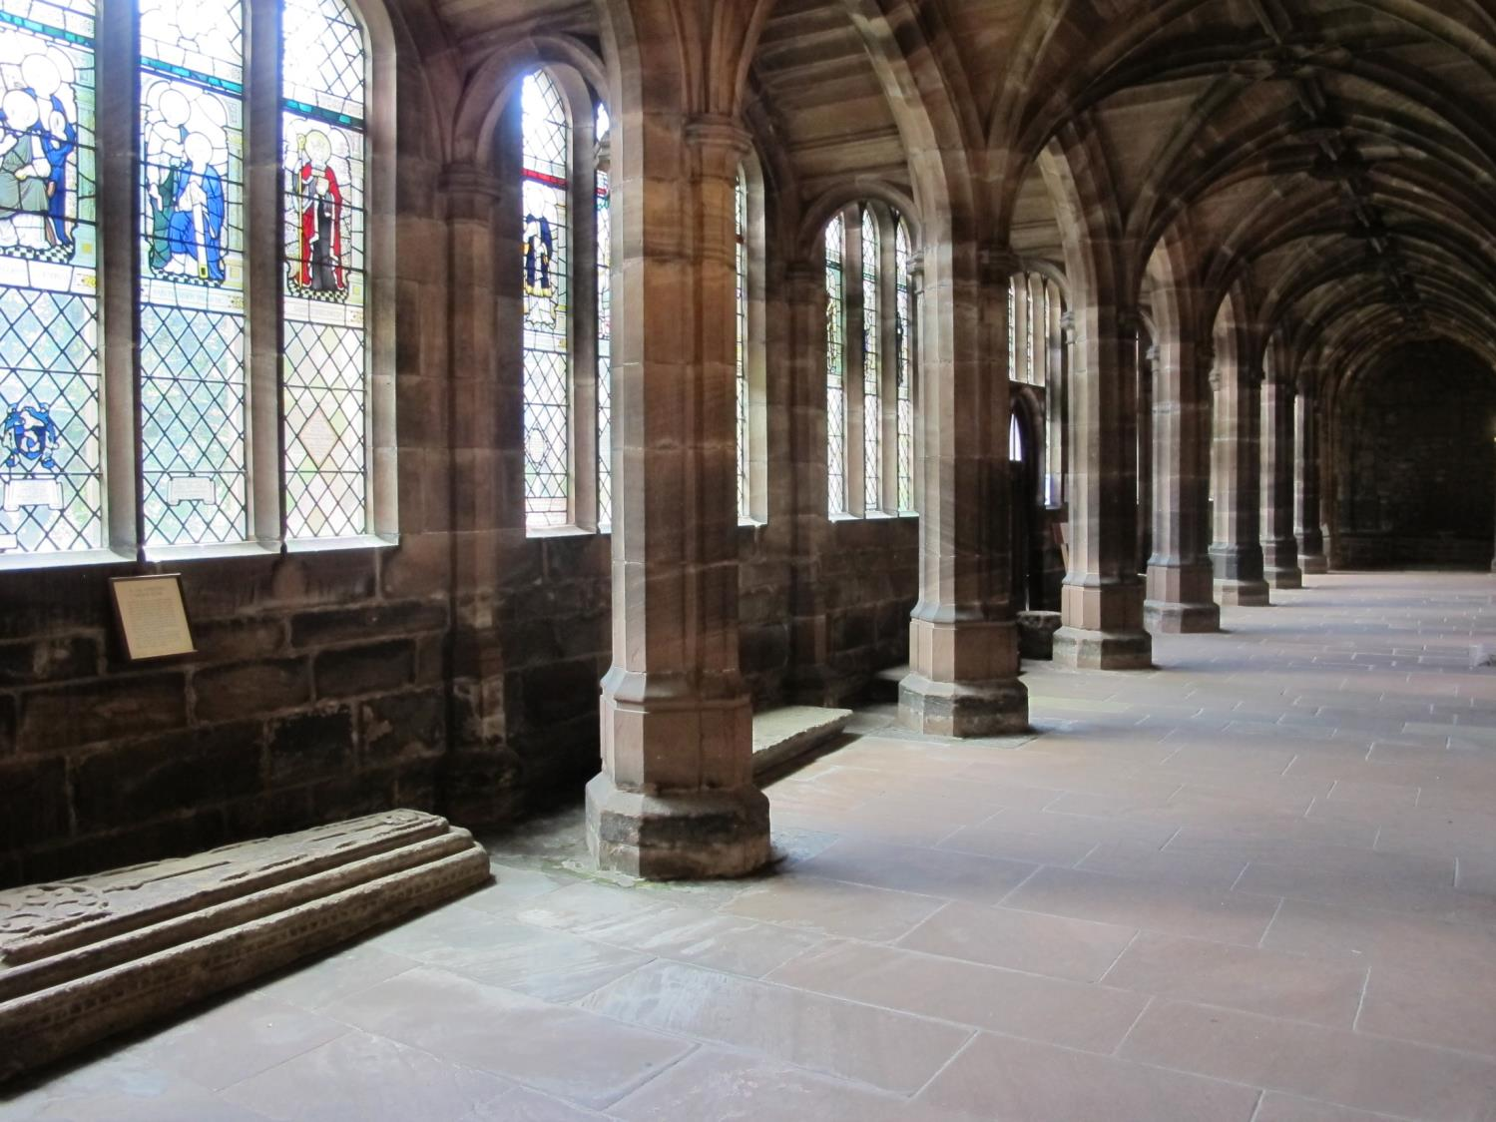
The Cloisters
Notes:
Teacher Notes: This is where the monks wrote using a quill. There was no glass in the windows then.
Teacher Questions: When would they have to stop writing ? (Note: There was no electricity so they couldn’t work in the dark)

Slide 84
Going into the Garth

Slide 85
Notes:
Teacher Notes: Go through the door in the cloisters into the garden called the garth.

Slide 86
The Garth
Notes:
Teacher Notes: The garth from a height showing the well

Slide 87
Notes:
Teacher Notes: In the middle of the garth is a garden with a pond in it where the monks used to grow herbs and vegetables. The sculpture is of the story in John chapter 4 about a woman giving Jesus a drink of water
Why do you think the sculptor called the statue ‘The Water of Life’?

Slide 88
In the cloisters

Slide 89
Notes:
Teacher Questions: Can you see the ledge in the wall? A lead trough full of water stood on the ledge.
The monks used to wash themselves in this water to be clean before they ate their meal. Do you do anything similar before meals?

Slide 90
Where the monks washed before a meal

Slide 91
Where the monks ate

Slide 92
The Refectory
Notes:
Teacher Notes: The monks ate in the Refectory. While the monks were eating, another monk read to them. They ate in silence
People are meeting after a service for a drink of coffee.
Teacher Question: How is that similar or different from your local church?

Slide 93
The ledge where a monk read whilst others ate
Notes:
Teacher note: The ledge is where one monk stood to read aloud during the meal
The monks read from the Bible or the Rule of St Benedict who set out the rules for the monks to live together.
Teacher Question: What is a good rule for people living in the same place?

Slide 94
St Benedict wrote the rules for the monks to live by

Slide 95
The creation Window

Slide 96
Notes:
Teacher note: This picture is at the end of the refectory where the monks ate. It was put in in 2000.
Teacher Question: Which story do you think this represents in the Bible? Why are there 6 panels?
What animals can you see?
Which panel do you like best?
Can you see: - the white dove -an outline of a hand -a foetus in the far right corner?

Slide 97
The shop
As visitors leave they may visit the shop.

Slide 98
Chester Cathedral shop
Notes:
Teacher Question: What would you sell in a shop in a cathedral? Why?

Slide 99
Abbey Gateway: one exit from the cathedral

Slide 100
Notes:
Teachers Question: What part of the cathedral did you find most interesting?
Which part did you like best? What would you like to see again?
What would you tell a friend about it?

Slide 101
An outline plan of the cathedral
Notes:
Teacher notes: This is an extra resource for teacher use to use as appropriate. The West door is at the bottom of the plan.

